Slide 1


British qualifications
in a nutshell
Search Engine project
        Marijke Blom-Westrik, policy officer
        8 December 2021, 09.30 hrs

Slide 2
Content
Overview British education system + National Qualification Framework (NQF)
Secondary education: GCSE en GCE AS en A Levels en BTECs
Access to higher education
Higher education: non-degree and degree education
Questions of the participants

Slide 3
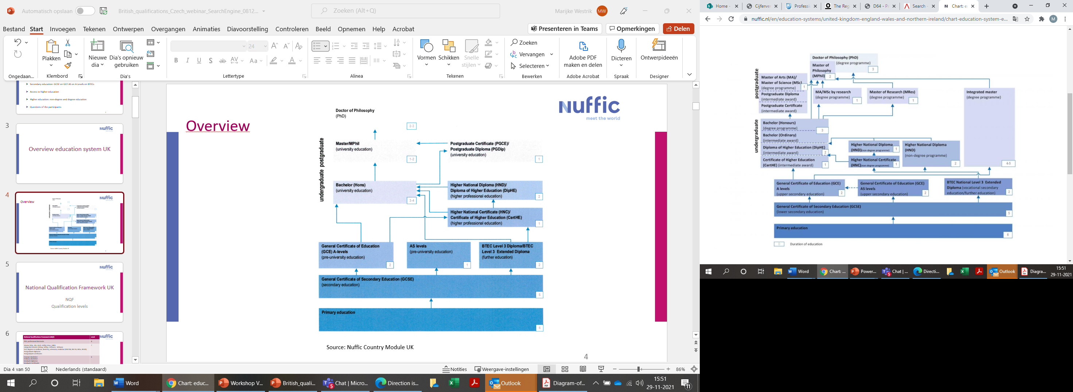
Chart
Source: Nuffic Country Module UK

Slide 4
Britse NQF
National Qualifications Framework (NQF) | Level
PhD, professional doctorate | 8
Master (MSc, MA, MLitt, MPhil, Mres, MBA) Integrated Masters (MEng, MPhys, MPharm, MChem) First degrees in medicine, dentistry, veterinary medicine (MB ChB, BM DS, BVSc, BVMS) Postgraduate diplomas Postgraduate Certificates | 7
Honours Bachelors Ordinary Bachelors Graduate diplomas Graduate Certificates | 6
Foundation degrees (FdA, FdSc) Diploma of Higher Education (DipHE) Higher National Diploma (HND) | 5
Certificate of Higher Education (CertHE) Higher National Certificate (HNC) | 4
GCE: Advanced Levels GCE: Advanced Subsidiary Levels Access to Higher Education Diploma | 3
GCSE (A-C) | 2
Source: http://www.qaa.ac.uk/docs/qaa/quality-code/qualifications-frameworks.pdf blz 17
Notes:
NVQs level 2-7
BTEC:
Bron: http://www.qaa.ac.uk/docs/qaa/quality-code/qualifications-frameworks.pdf blz 17

Slide 5
General Certificate of Secondary Education
GCSE: Lower secondary education

Slide 6
GCSE
General Certificate of Secondary Education (NQF Level 2)
(International variant: O Levels, IGCSE)
  Nominal duration 5 years (Years 7-11), after 6 years of primary education
  Broad choice of subjects: generally 5 – 10 subjects completed, in different sessions at different examination boards
Notes:
Compulsory national curriculum subjects zijn de core subjects English, math, science maar meer compulsory in de zin van dat de school ze moet aanbieden, niet dat je er eindexamen in moet doen op GCSE niveau.
Ofqual reguleert de exam boards.

Slide 7
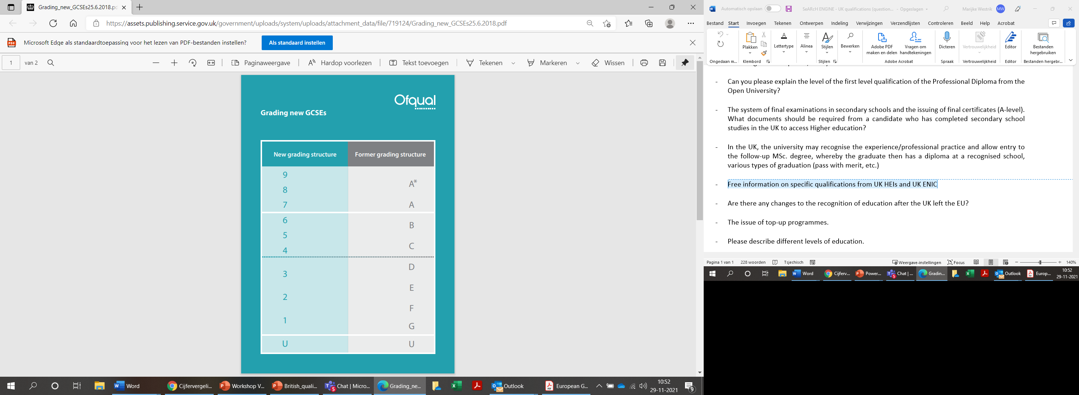
GCSE
    Examination boards:
    AQA, OCR, Pearson Edexcel, Cambridge International Examinations.
    Grading system:
    Old: A* - G. A* not used everywhere.
    New (since 2017 for some subjects): 9-1, 9 being the highest.
    Grade inflation.
https://assets.publishing.service.gov.uk/government/uploads/system/uploads/attachment_data/file/719124/Grading_new_GCSEs25.6.2018.pdf

Slide 8
GCSE
    Examples of GCSE subjects (lists per Examination Board):
    https://www.aqa.org.uk/qualifications (see under GCSE)
    http://www.cambridgeinternational.org/programmes-and-qualifications/cambridge-secondary-2/cambridge-igcse/subjects/
    https://qualifications.pearson.com/en/qualifications/edexcel-gcses.html
    https://www.ocr.org.uk/qualifications/gcse/
Notes:
General Studies, PE: AQA General Studies A en B. Alternatief is Extended Project . Nadruk op skills (thinking skills, work independently).
Cie: Global Perspectives, PE. Learners broaden their outlook through the critical analysis of - and reflection on - issues of global significance. The Cambridge International AS & A Level Global Perspectives and Research syllabus is based on skills rather than on specific content. Learners develop research, thinking, reasoning and communication skills by following an approach to analysing and evaluating arguments and perspectives called the Critical Path. Collaborative skills are enhanced through participation in a team project.

Slide 9
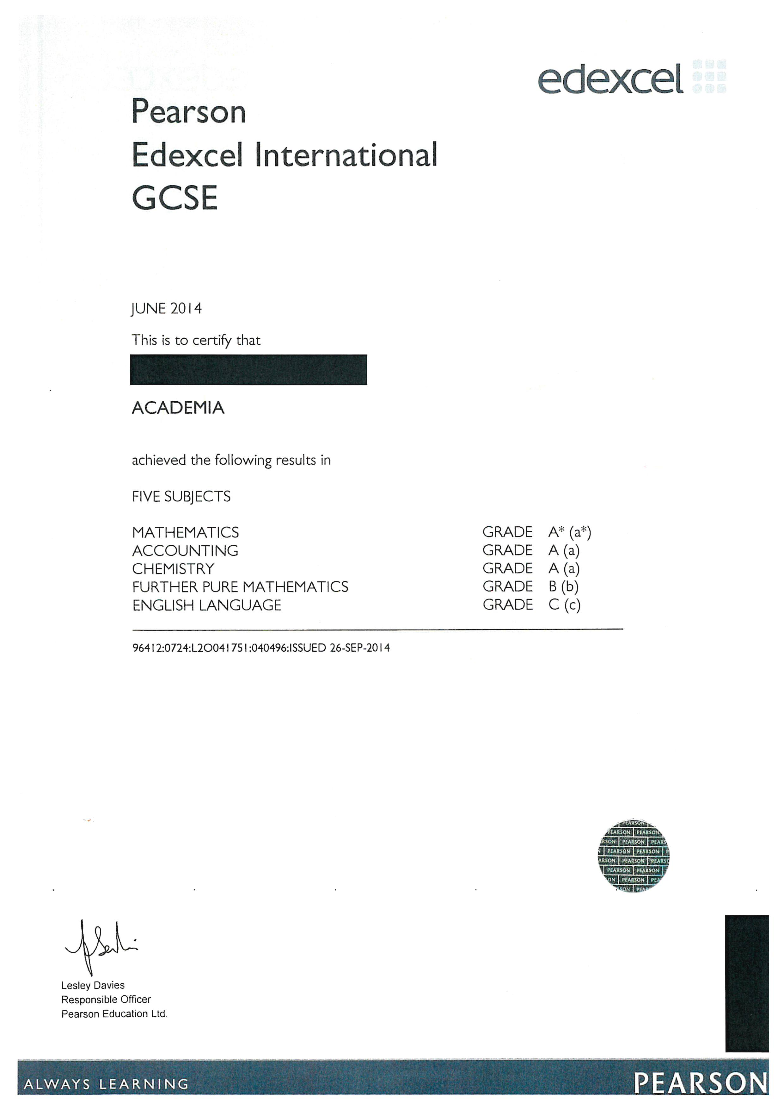
GCSE
  2 pathways for further studies:
    Academic: AS/A Levels with A-C, minimally 5 subjects required.
    Vocational: vocational courses with GCSE’s (D-G), e.g. BTECs, SVQs.
Notes:
Compulsory national curriculum subjects zijn de core subjects English, math, science maar meer compulsory in de zin van dat de school ze moet aanbieden, niet dat je er eindexamen in moet doen op GCSE niveau.

Slide 10
General Certificate of Education: upper secondary education
GCE: Advanced Subsidiary (AS) & Advanced Level (AL)

Slide 11
GCE: upper secondary education
    GCE: General Certificate of Education – AS levels (NQF Level 3)
    Advanced Subsidiary Levels: nominal duration 1 year
    Broad choice of subjects: generally 3 AS subjects completed, different sessions of different examination boards
    Equivalent to ½ A Level, now independent qualification.
    Same Examination boards as GCSE.
    Grading system: A-E. Grade inflation.
    Types of subjects: academic, vocational, art, skills/interdisciplinary.

Slide 12
GCE: AS Levels
    Examples of GCE subjects – AS and A Levels (lists per Examination Board):
    https://www.aqa.org.uk/qualifications
    http://www.cambridgeinternational.org/programmes-and-qualifications/cambridge-advanced/cambridge-international-as-and-a-levels/subjects/
    https://qualifications.pearson.com/en/qualifications/edexcel-a-levels.html
    https://www.ocr.org.uk/qualifications/as-a-level-gce/
Notes:
General Paper: The Cambridge International AS Level General Paper encourages learners to develop a maturity of critical thought and argument, and a mastery of expression in the English language. These are all skills of great use for university level study. The syllabus draws on topics from across the school curriculum, and learners are able to draw upon knowledge and understanding gained from study of other subjects.
CIE: Thinking Skills
Pearson: General Studies: Students of our Edexcel A level in General Studies will view issues from a wider range of perspectives than those offered by subject specialism. They will integrate knowledge from a range of disciplines in order to develop an understanding of the interrelationship between them and encourage a broader and deeper understanding of issues.
Extended Project Qualification Level 3: https://qualifications.pearson.com/en/qualifications/edexcel-project-qualification/level-3.html Research skills.

Slide 13
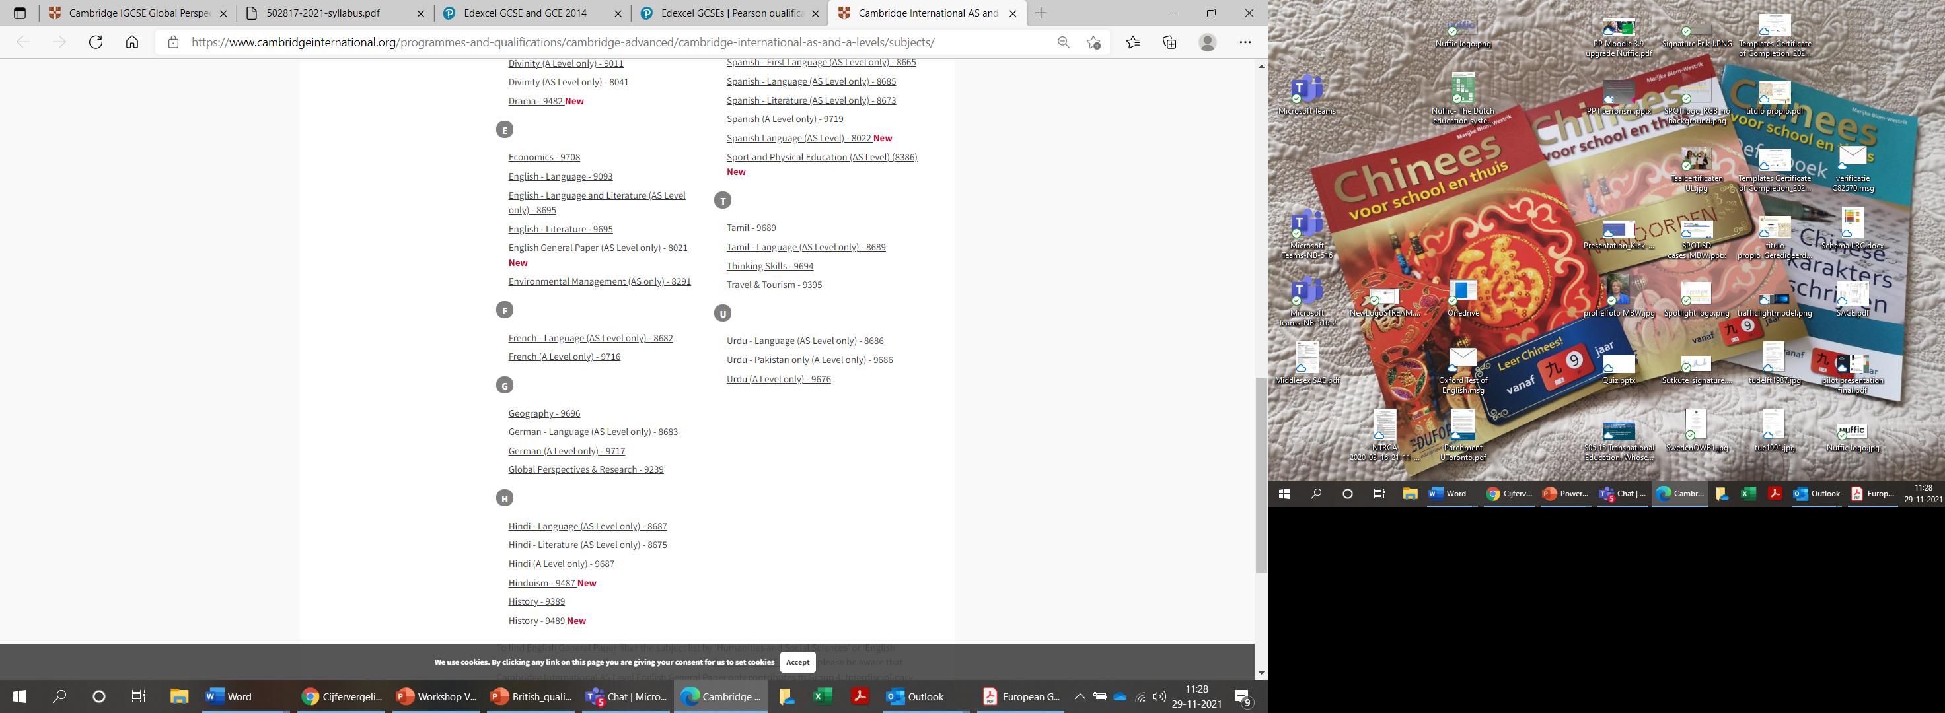
GCE: AS Levels
    Chat question:
    What do you think about the subjects English General Paper, Global Perspectives and Research, Thinking Skills and Physical Education?
Cambridge international
AS and A levels

Slide 14
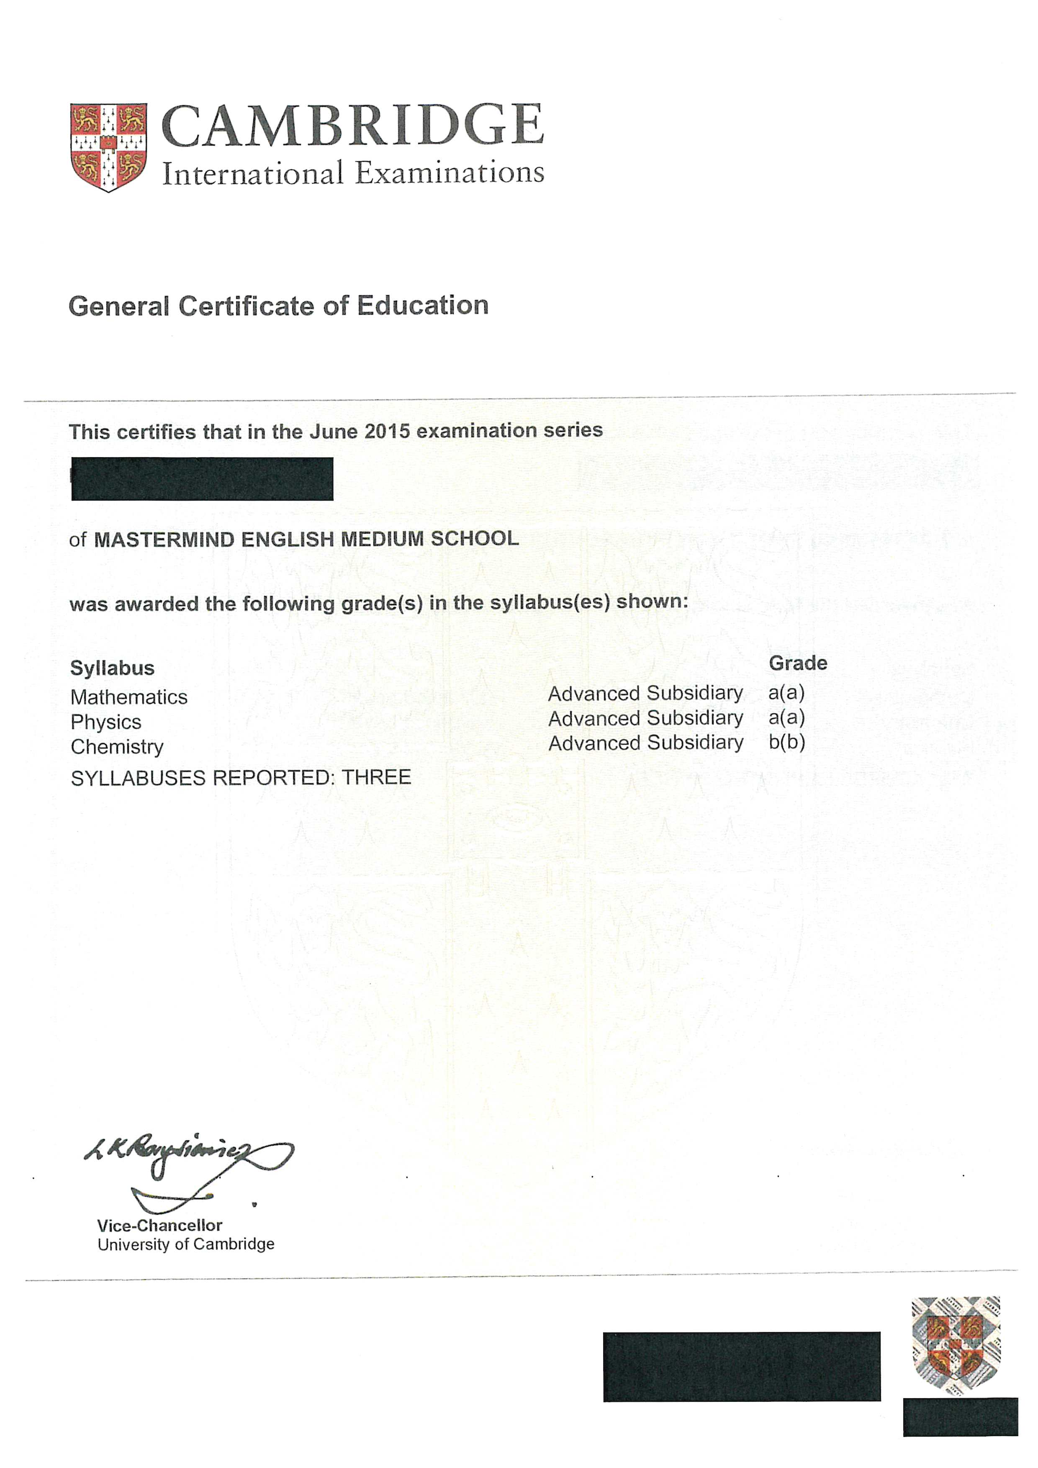
GCE
AS Level

Slide 15
GCE: A levels
    GCE: General Certificate of Education (NQF Level 3)
    Advanced Level: nominal duration 2 years
    3 AL needed for access to HE
    Grading: A*-E. Grade inflation.
    In UK 1 A Level equals to 2 AS Levels.

Slide 16
File requirements
    Provisional results and final results
    Statement from the school which subjects the student is following
    When BTEC is studied, not always clear which qualification: ask Qualification Number (check in Ofqual)
    Ask for the final certificates from the Examination Boards (GCSE+GCE/BTEC)
    Provisional result slips available in August: https://www.gov.uk/government/publications/direction-issued-to-ofqual
    Review of marking or appeal might change student’s results
    Final certificates from some Examination Boards available from half October.

Slide 17
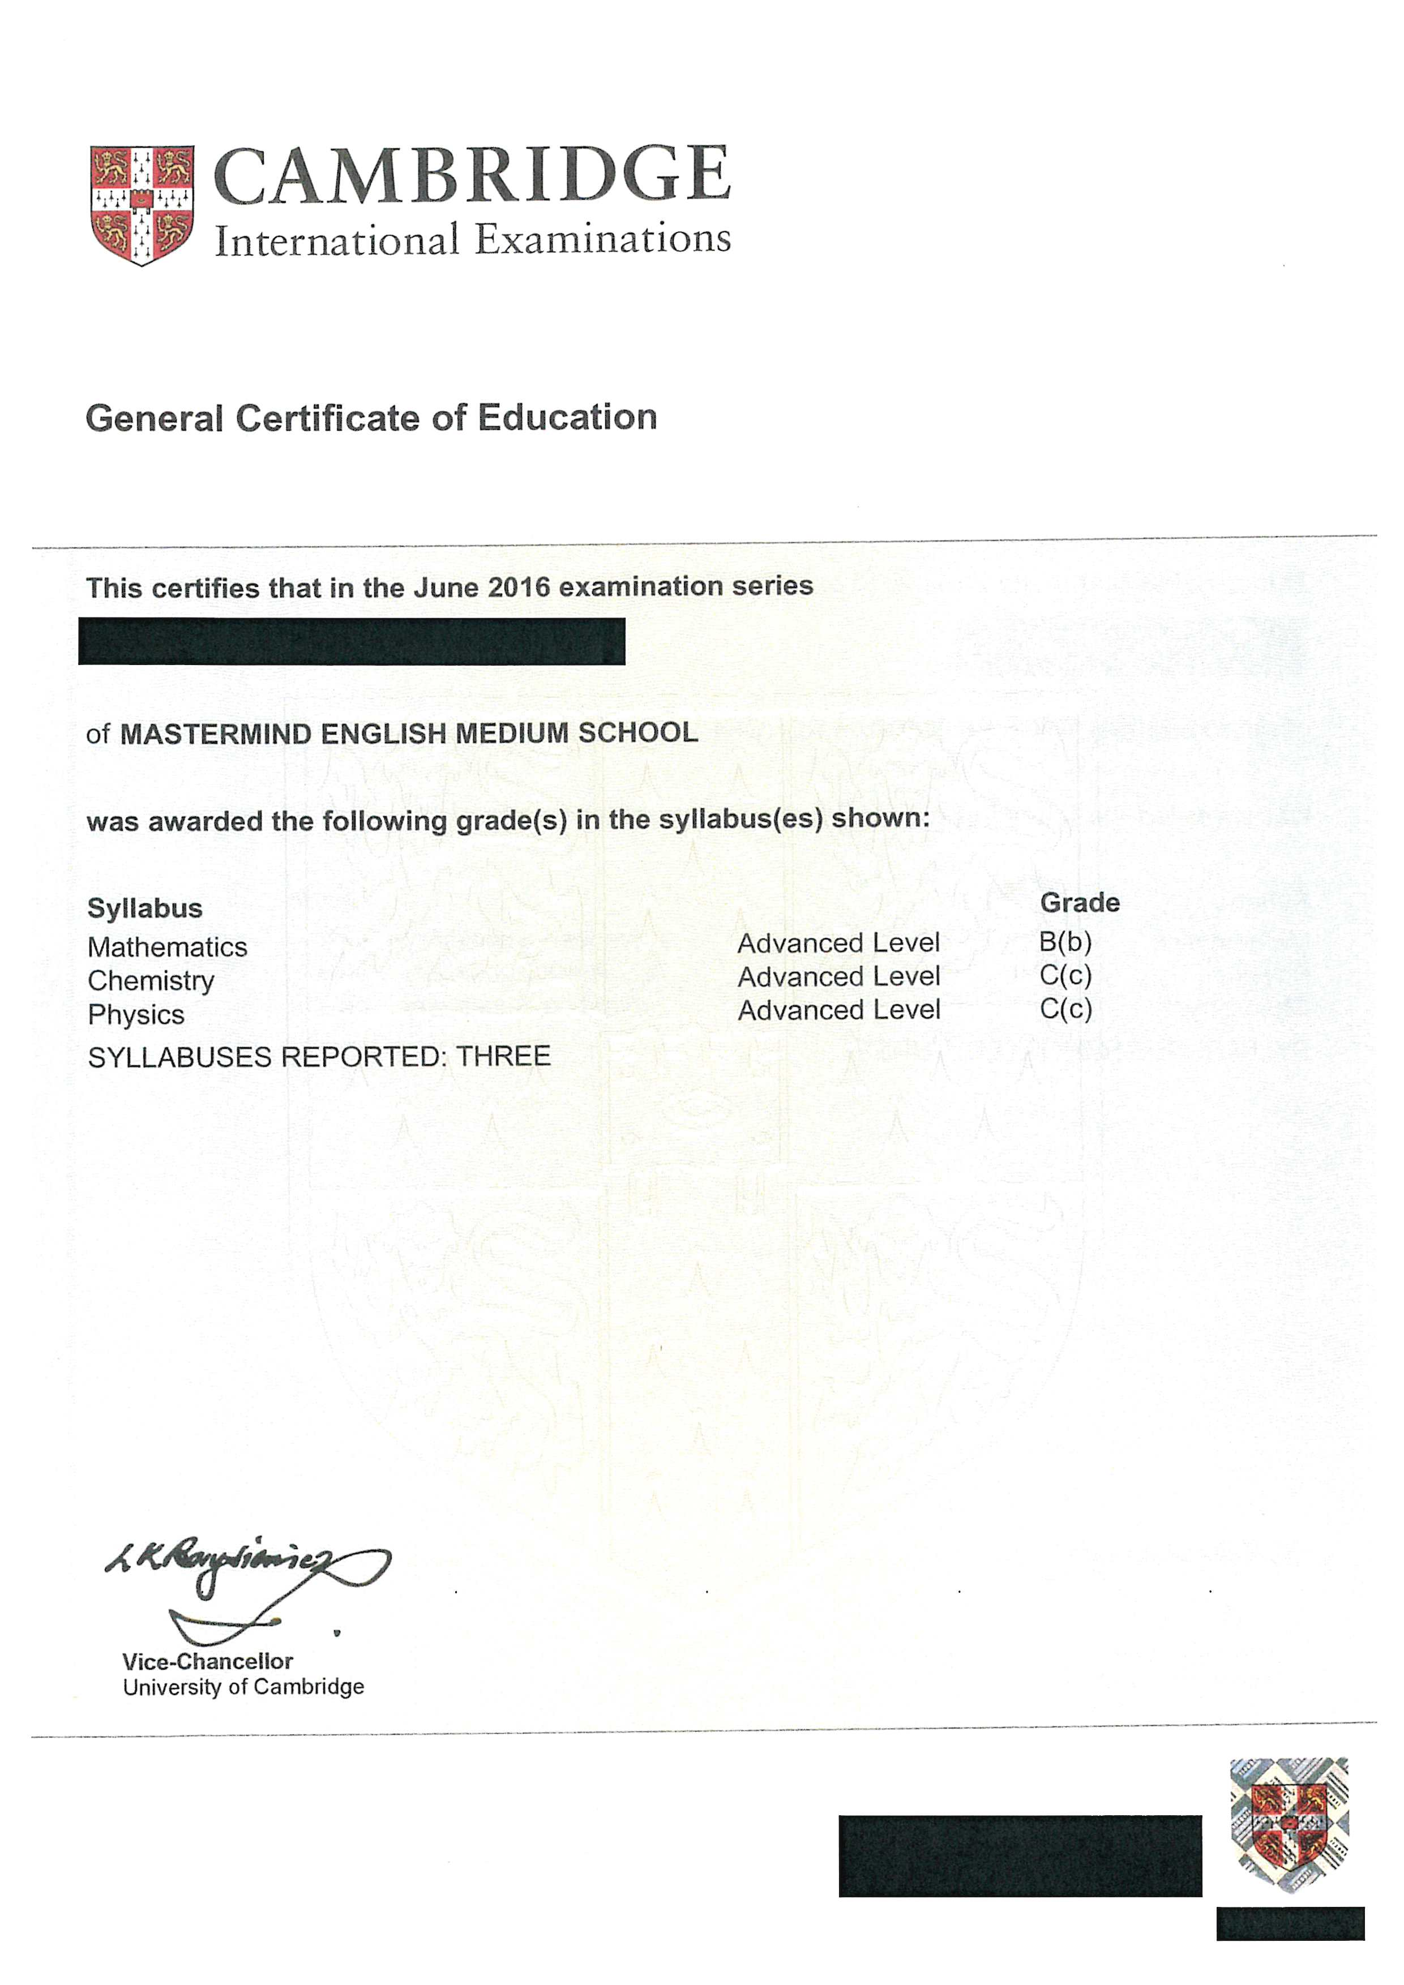
GCE
A Level

Slide 18
Verification with CIE: CIE Direct
  Database CIE Direct: https://direct.cie.org.uk/login_form?came_form=https://direct.cie.org.uk
  Cambridge International Education verification database
  Free registration via info@cie.org.uk.

Slide 19
Business and Technology Education Council
BTECs Level 3
Secondary vocational education

Slide 20
BTEC (secondary vocational)
BTEC Nationals Level 3 | Credits | Duration | British equivalent
Certificate | 30 (180 GLH*/300 TQT) | 0,5 year (4 months) | 1 AS (A-E)
Subsidiary Diploma | 60 (360 GLH/600 TQT) 6 units | 0,5-1 year (8 months) | 1 AL (A*-E)
90-credit Diploma | 90 (540 GLH/900 TQT) | 0,5-1 year (12 months) | 1.5 AL
Diploma | 120 (720 GLH/ 1200 TQT), 12 units | 1-2 year (18 months) | 2 AL
Extended Diploma | 180 (1080 GLH/1800 TQT), 18 units | 2 year (24 months), 1 year after 90-credit Diploma | 3 AL
Compare: GCSE’s | 120 GLH
Compare: GCE A Levels | 360 GLH
*GLH: guided learning hours = contact hours, now TQT Total Qualification Time
Notes:
Business and Technology Education Council.

Slide 21
BTECs
    BTECs offered from Entry Level to Level 7: BTEC Firsts (Entry Level, Level 2); BTEC Nationals from Level 3
    Vocational, practical
    Programme consists of units
    Officially equivalent to A Levels in the UK
    All programmes except Extended Diploma can be combined with single GCE subjects
    25% of the UK universities accept BTEC Level 3 qualifications for admission.
    Entry requirement for Level 3 BTECs: 4 or 5 GCSE’s (A*-C or D)
    From Subsidiary Diploma or 90-Credit Diploma: 1 year additional study towards Extended Diploma.
Notes:
https://www.brooklands.ac.uk/wp-content/uploads/2018/09/fulltime.pdf

Slide 22
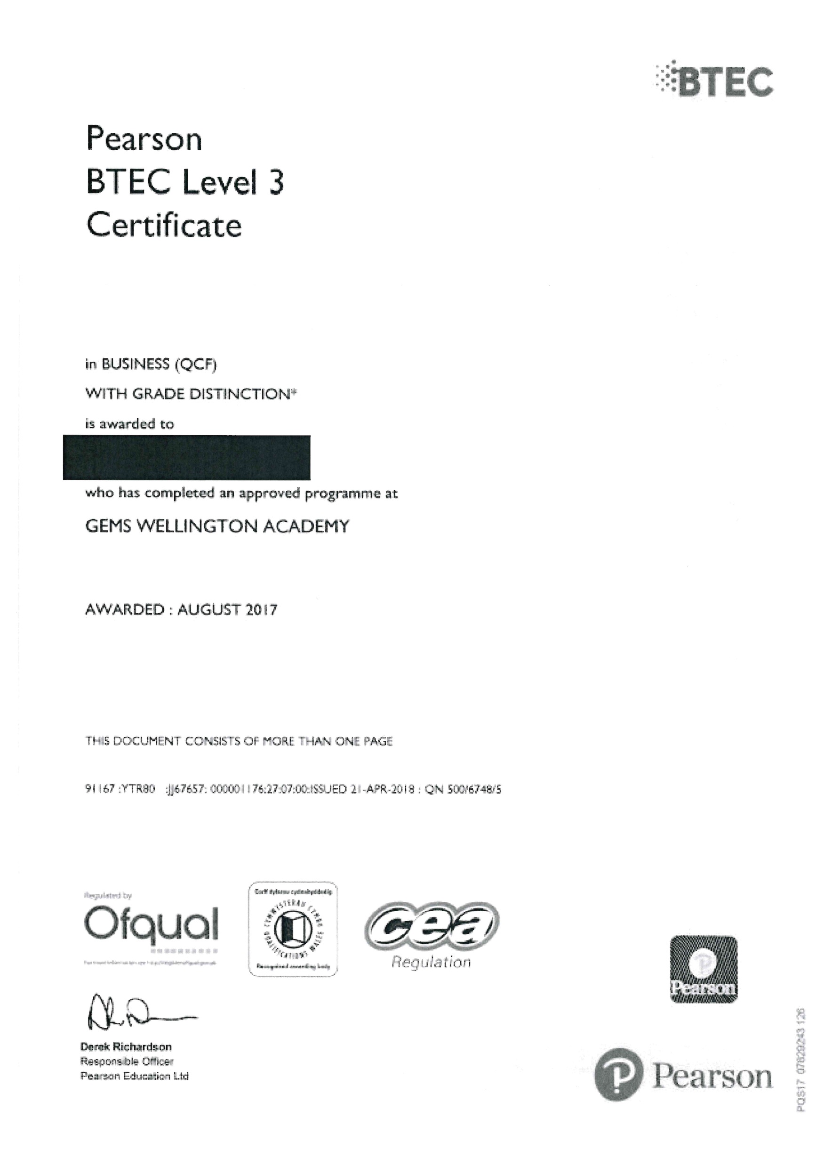
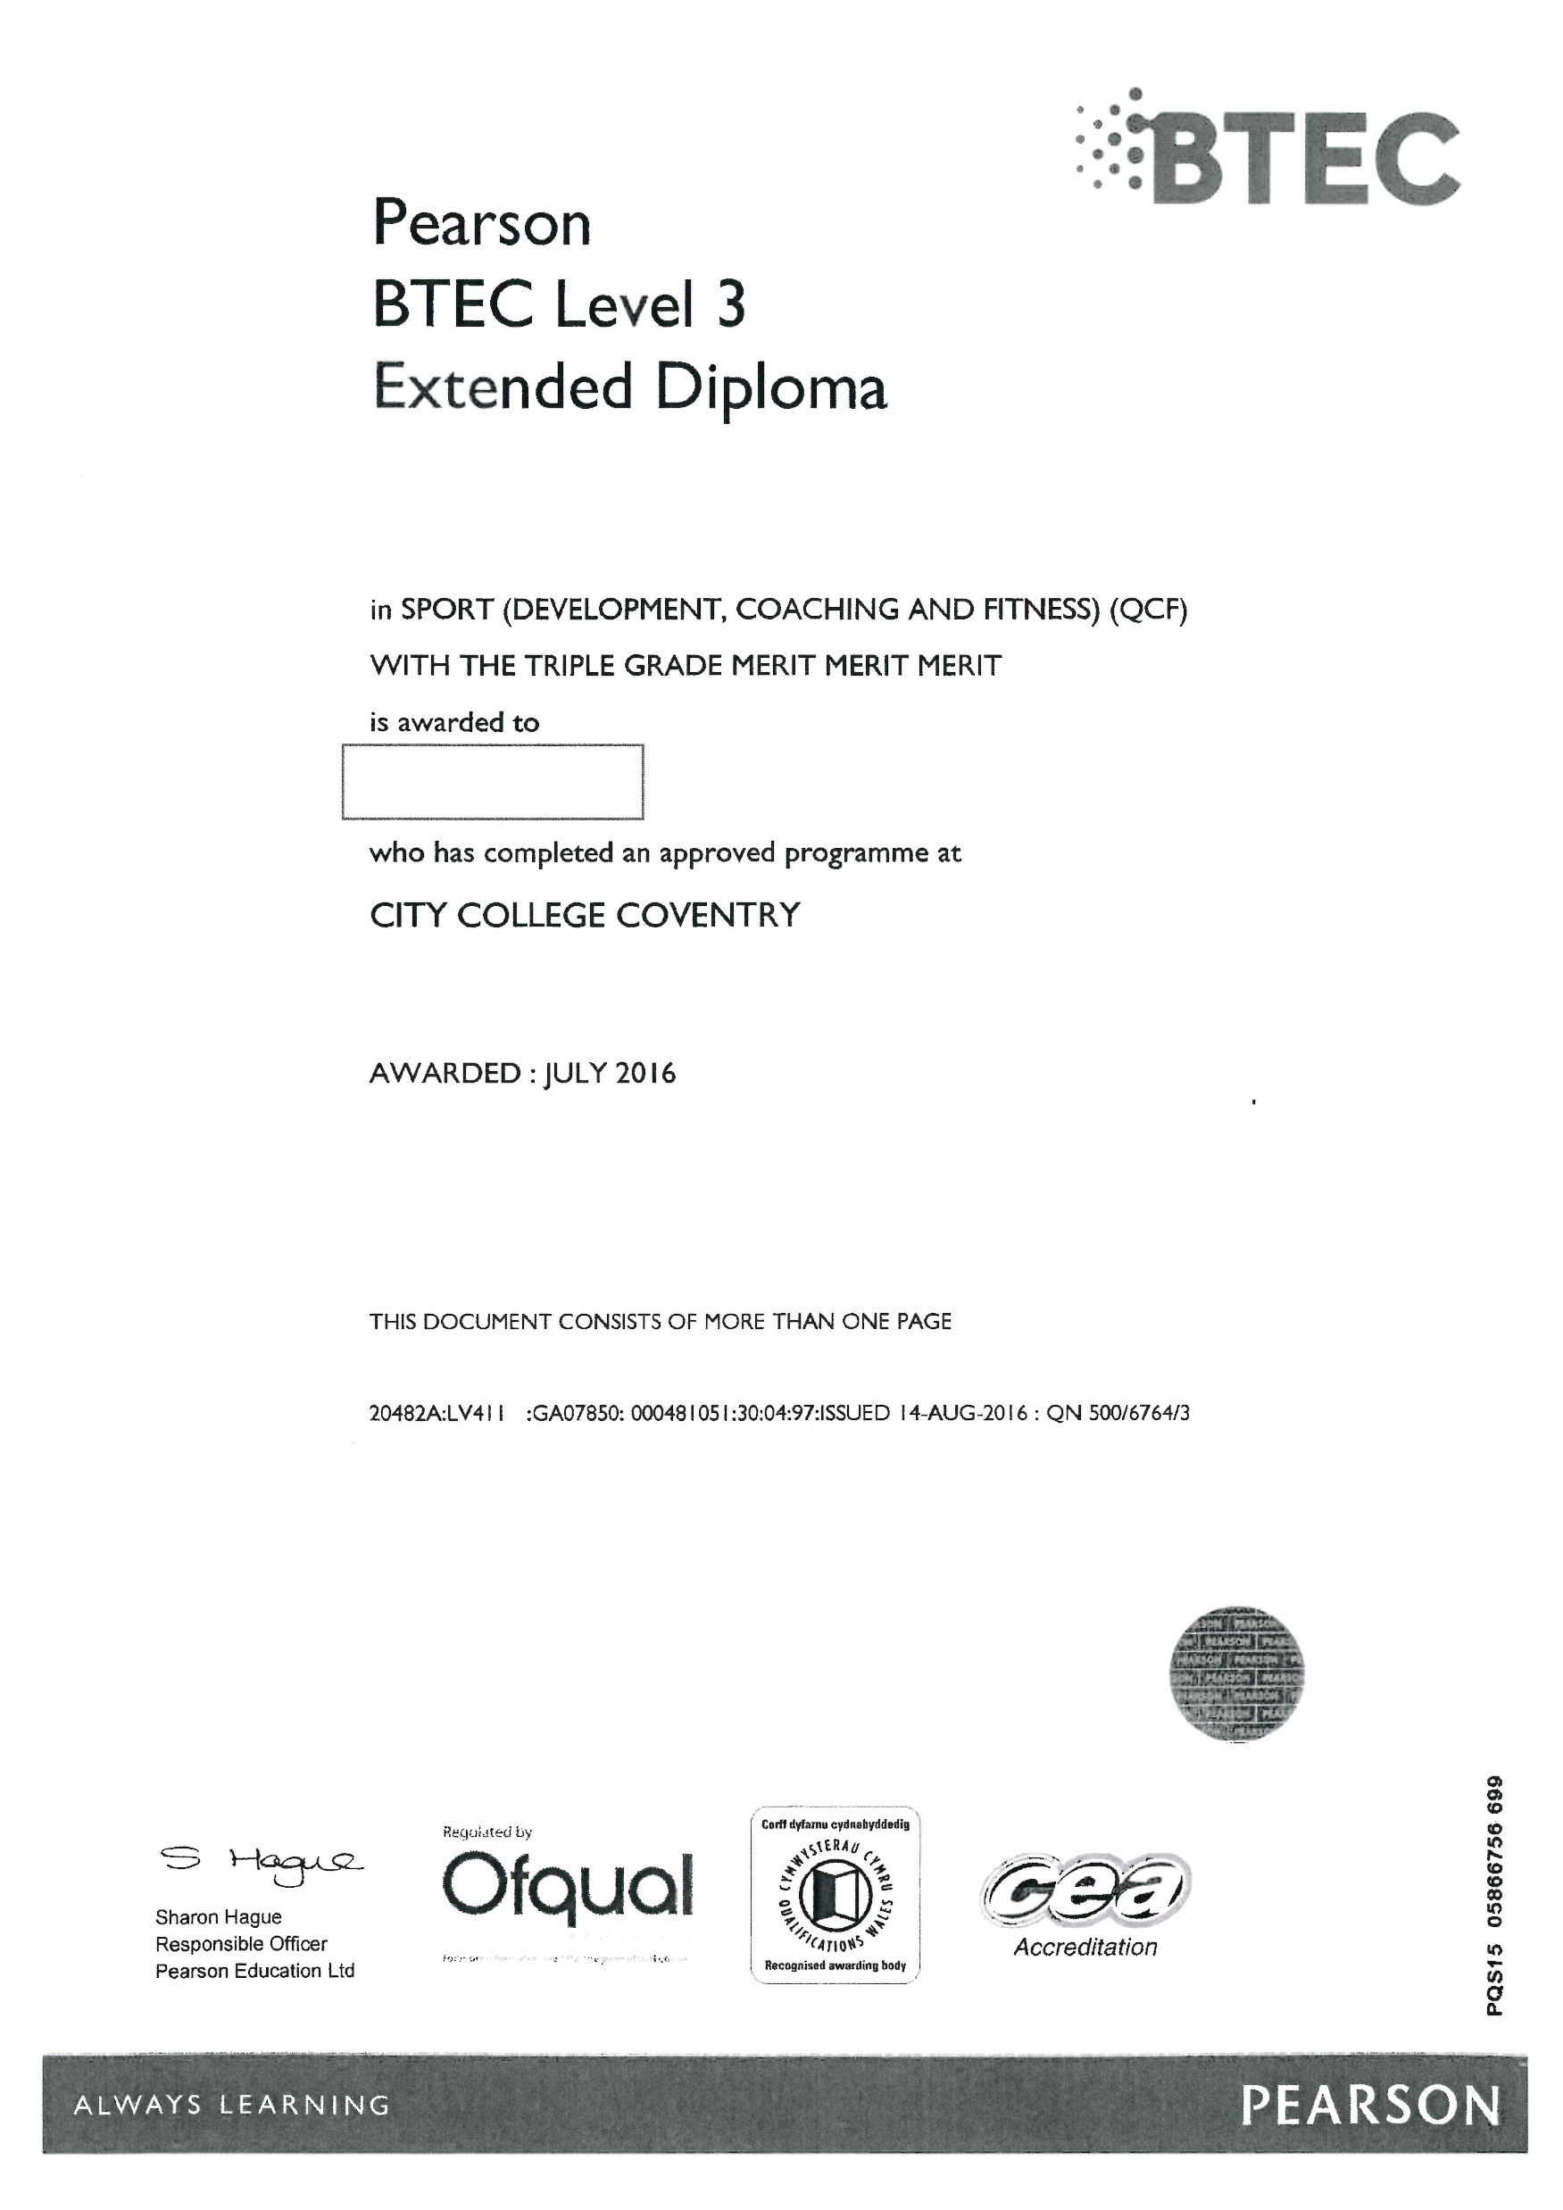
BTEC
Extended
Diploma
Qualification number

Slide 23
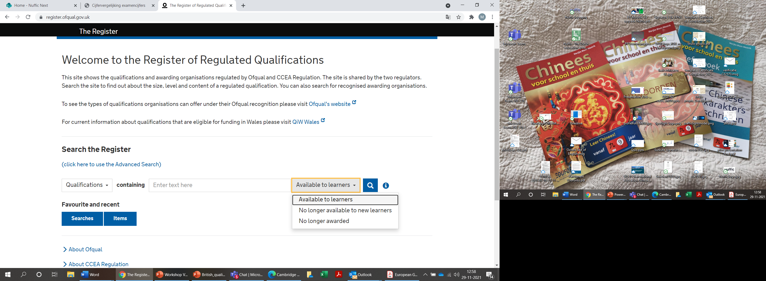
Ofqual register
    Ofqual: database of secondary (vocational) education and non-degree programs: https://register.ofqual.gov.uk/ (check qualification number)

Slide 24
Admission to HE in UK
    3 different Advanced Levels (A-B or A-C) (abbreviated as AAB or A*AA, etc.), required subjects differ per study program: preferred subjects & non-preferred subjects
    Sometimes specific GCSEs required.
    25% of British HEI (less selective ones) admit students with relevant BTEC Extended Diploma or other Level 3 qualifications with a lower study load in combination with A Levels.

Slide 25
Access to Dutch HE with UK qualifications
  Evaluation of British GCSEs and GCEs the Dutch way:
  4 GCSE’s (A-C) + 2 AS (A-C) in 6 different subjects > access to professional bachelor. AS levels preferably in relevant subjects.
  BTEC Level 3 Extended Diploma > access to professional bachelor
  3 GCSE’s (A-C) + 3 AL (A-C) in 6 different subjects > access to research bachelor. AL in relevant academic subjects.
  No skills subjects accepted, only as additional subject.
  Dutch HEI decide on relevant subjects and develop own policy.
  A level with D or E counts as AS level (A-C). AS level D or E counts as GCSE (A-C).
  Our policy is a mixture, based on what British universities do and what we require from Dutch students.
Notes:
https://www.aqa.org.uk/subjects https://qualifications.pearson.com/en/qualifications/edexcel-gcses.html http://www.cambridgeinternational.org/programmes-and-qualifications/cambridge-advanced/cambridge-international-as-and-a-levels/subjects/
Global perspectives: CIE: Cambridge IGCSE Global Perspectives is a groundbreaking and stimulating course that stretches across traditional subject boundaries and develops transferable skills. It is both cross-curricular and skills-based and taps into the way learners of today enjoy learning, including team work, presentations, projects, and working with other learners around the world. The emphasis is on developing the ability to think critically about a range of global issues where there is always more than one point of view.
General Paper:
General Studies: develop their thinking skills, capacity to construct arguments and ability to draw conclusions. Students will have the opportunity to improve their communication and presentation skills and gain experience of working independently and with others
Citizenship studies (AQA): knowledge of democracy, government and law, and develop the ability to create sustained, well balanced arguments. Communication skills are increasingly sought after by employers: our specification will enhance students’ writing and speaking styles.

Slide 26
Admission to HE in Czech Republic
For Bachelor's programmes and integrated Master's programmes
minimum requirement for fulfilling the condition of Section 48(1) and (4)(d) of Act No. 111/1998 Coll. on Higher Education is the completion of secondary education entitling access to higher education in the country of origin.
5 GCSE subjects and 2 A Levels
For Cambridge Pre-U: 3 principal subjects + Global Perspectives and Research (GPR) course and evidence of lower secondary education at GCSE level
Faculties may specify or tighten the requirements for individual study programmes according to § 49 of the School of Education and Science.

Slide 27
Evaluating GCSE/GCE subjects
  Accepting certain grade ranges (e.g., A-B or A-C)
  Accepting certain subjects (preferred subjects): only academic subjects or also vocational?
  Would you accept subjects that are considered non-preferred subjects in the UK, e.g.:
    Skills subjects like global perspectives (CIE), general paper (CIE), thinking skills (CIE), general studies (AQA & Edexcel), global development (Edexcel) en physical education
    creative subjects like design & technology, drama, theatre studies, media studies. Accept only when relevant for the bachelor.
    vocational vakken like business studies, accounting, home economics. Accept only when relevant for the bachelor.
  British universities use preferred and non-preferred subjects. Skills subjects and non-academic subjects are generally not accepted.
  Selective universities required AAA, less selective ones require ABB or BBB. Not many C’s.
Notes:
https://www.aqa.org.uk/subjects https://qualifications.pearson.com/en/qualifications/edexcel-gcses.html http://www.cambridgeinternational.org/programmes-and-qualifications/cambridge-advanced/cambridge-international-as-and-a-levels/subjects/
Global perspectives: CIE: Cambridge IGCSE Global Perspectives is a groundbreaking and stimulating course that stretches across traditional subject boundaries and develops transferable skills. It is both cross-curricular and skills-based and taps into the way learners of today enjoy learning, including team work, presentations, projects, and working with other learners around the world. The emphasis is on developing the ability to think critically about a range of global issues where there is always more than one point of view.
General Paper:
General Studies: develop their thinking skills, capacity to construct arguments and ability to draw conclusions. Students will have the opportunity to improve their communication and presentation skills and gain experience of working independently and with others
Citizenship studies (AQA): knowledge of democracy, government and law, and develop the ability to create sustained, well balanced arguments. Communication skills are increasingly sought after by employers: our specification will enhance students’ writing and speaking styles.

Slide 28
Combination other education systems
  For example: 3 A levels with previous studies in another education system.
  Previous education needs to be equivalent to GCSE level, e.g.:
  International Baccalaureate: Middle Years Program + 3 A levels
  Germany: Realschulabschluss Gymnasium + 3 A levels
If previous education is lower than GCSE (A-C), 4 relevant A levels compensates.
Previous education needs to be 11 years of education.

Slide 29
Higher education non-degree and degree
NQF Levels 4 – 8

Slide 30
HE in UK
    Credit system: Credit Accumulation and Transfer System (CATS)
    Undergraduate level 120 credits per year (= 60 ECTS)
    Master level 180 credits per year (= 90 ECTS)
    2 CATS = 1 ECTS (officially); ECTS = 25-30 hrs; CATS = 10 hrs.
    Some universities do not use CATS but another system or no credits at all

Slide 31
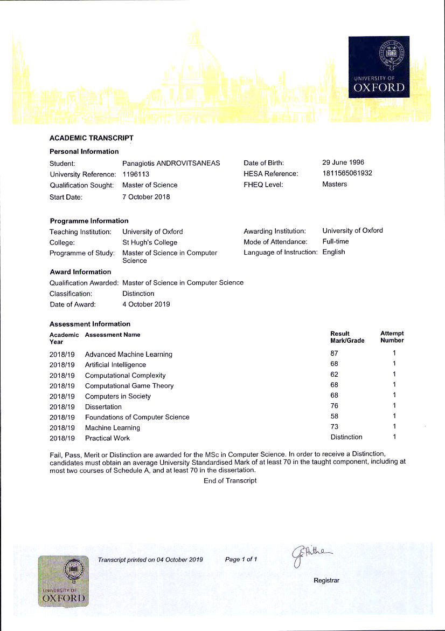
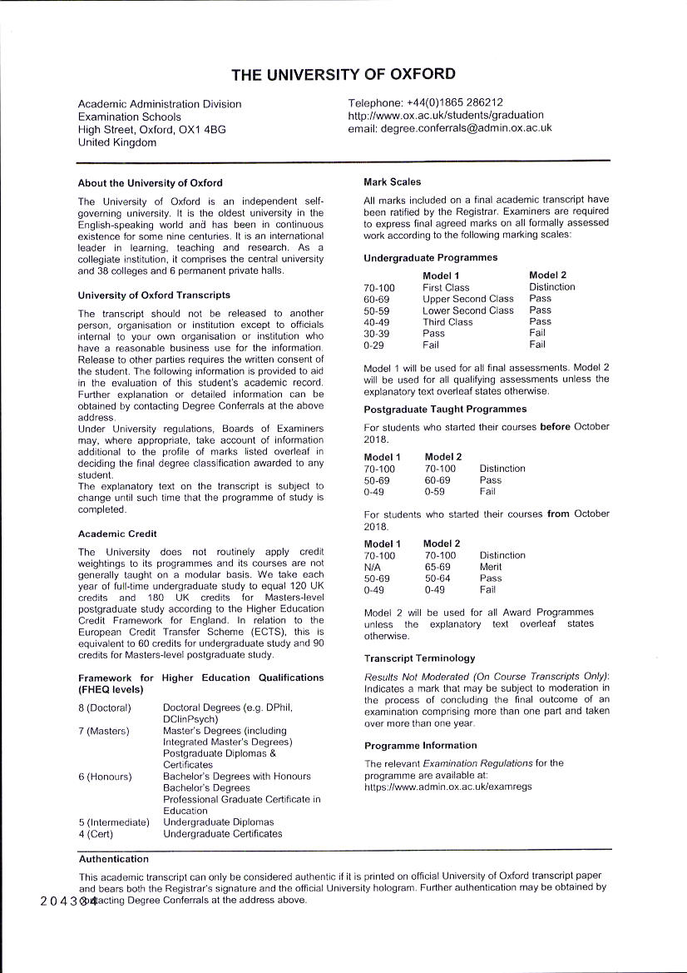

Slide 32
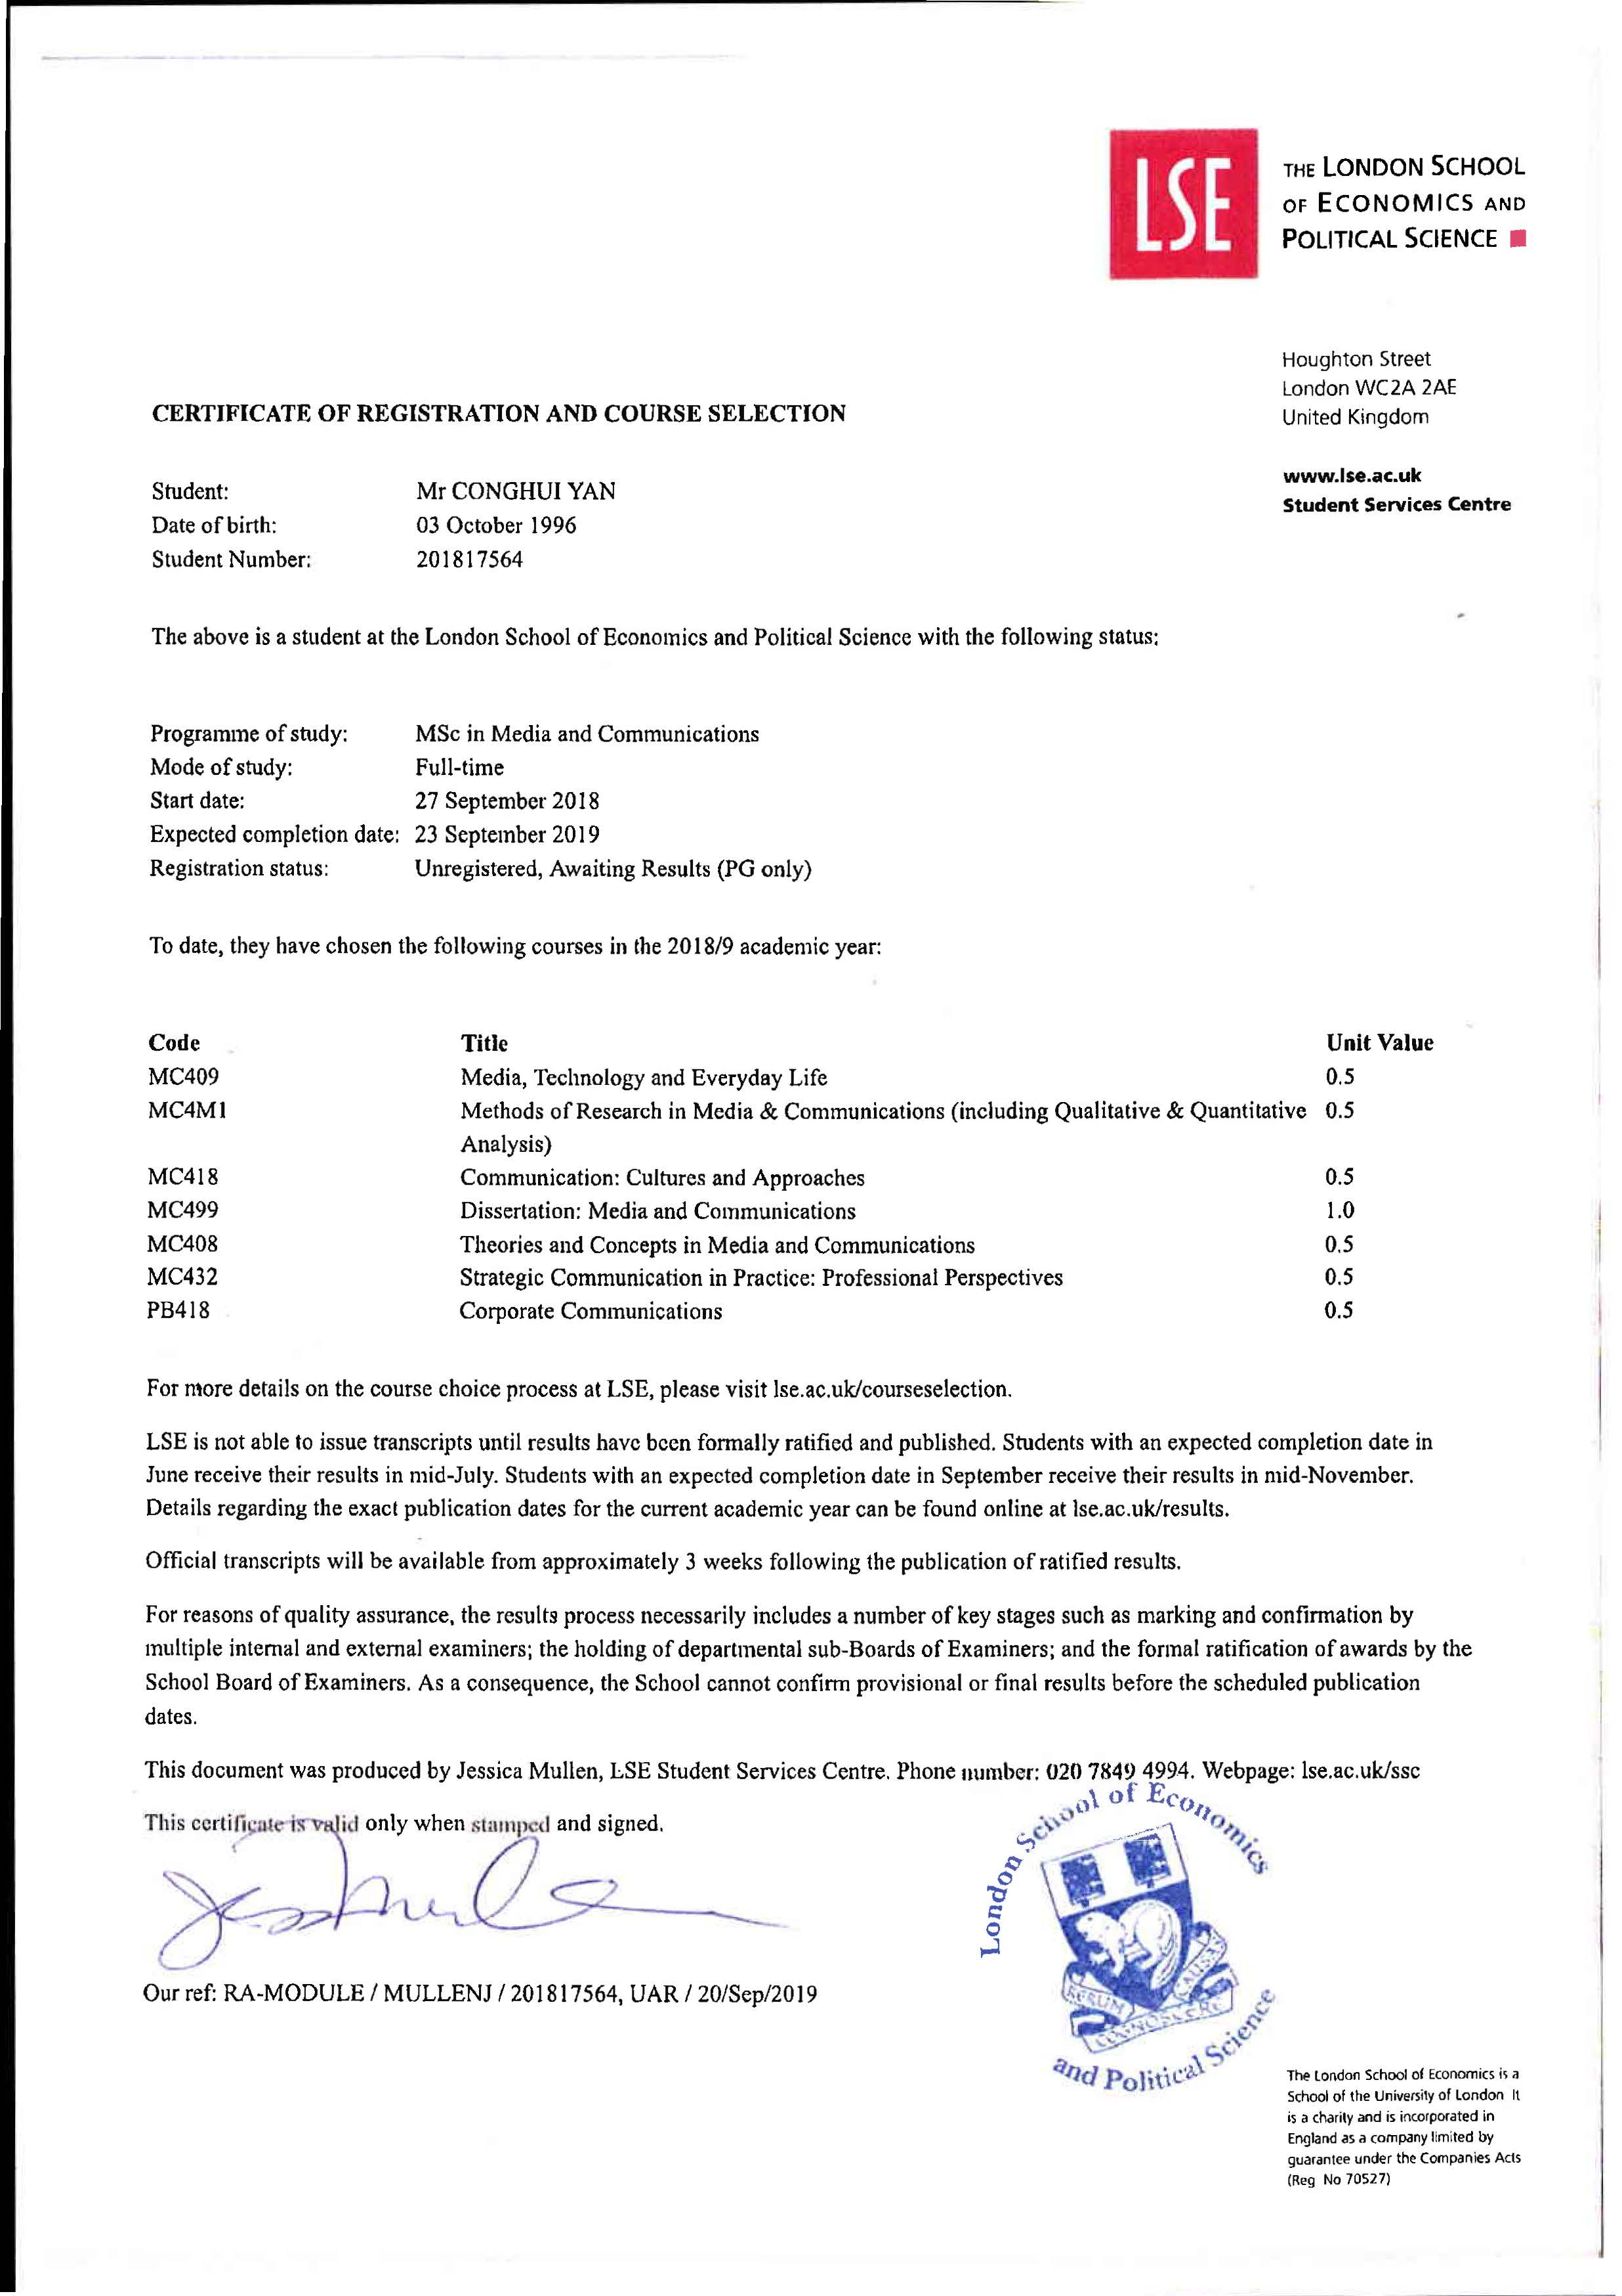
Although the School regards its degrees as fully compliant with the requirements of the Bologna Process, and with the first and second cycle learning outcomes described by the Qualifications Framework for the EHEA, LSE does not articulate student achievement in credit terms, ECTS or otherwise. We consider our 12-month master's degrees as being equivalent to 90 ECTS credits and 9/10-month postgraduate degrees [Diploma or MSc] as being equivalent to approximately 80 ECTS credits. This assumption is based on the learning outcomes achieved by successful candidates and on the notional learning times required to achieve them.
Program req.:
3 units coursework
+ dissertation (1 unit)
= 4 units

Slide 33
File requirements HE for UK
    Diploma/degree certificate
    Academic Transcript, digital transcripts, HEAR (Higher Education Achievement Report)/Diploma Supplement
    LSE: digital transcript > student sends a link from internal database of LSE: see https://verify.lse.ac.uk/verifier/servlet/DocumentVerifierApp/template/LoginScreen.vm

Slide 34
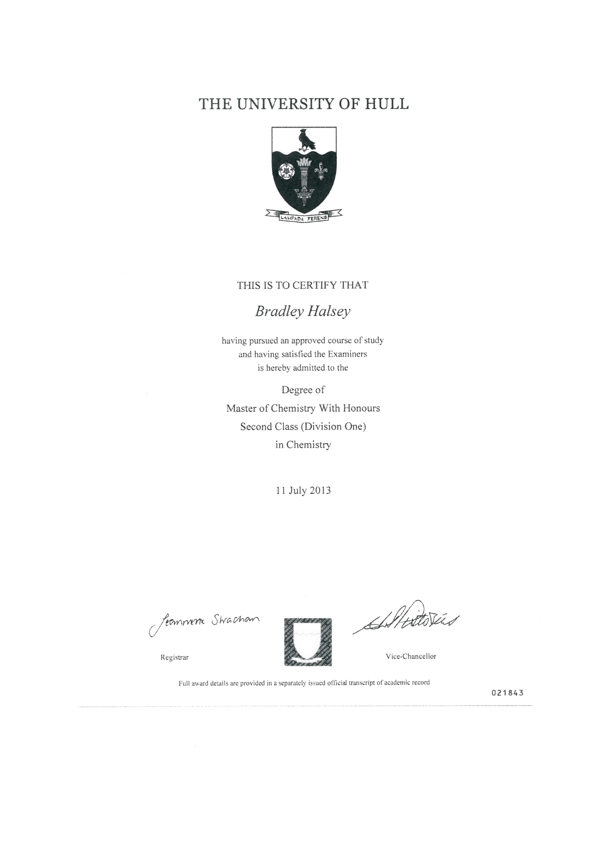
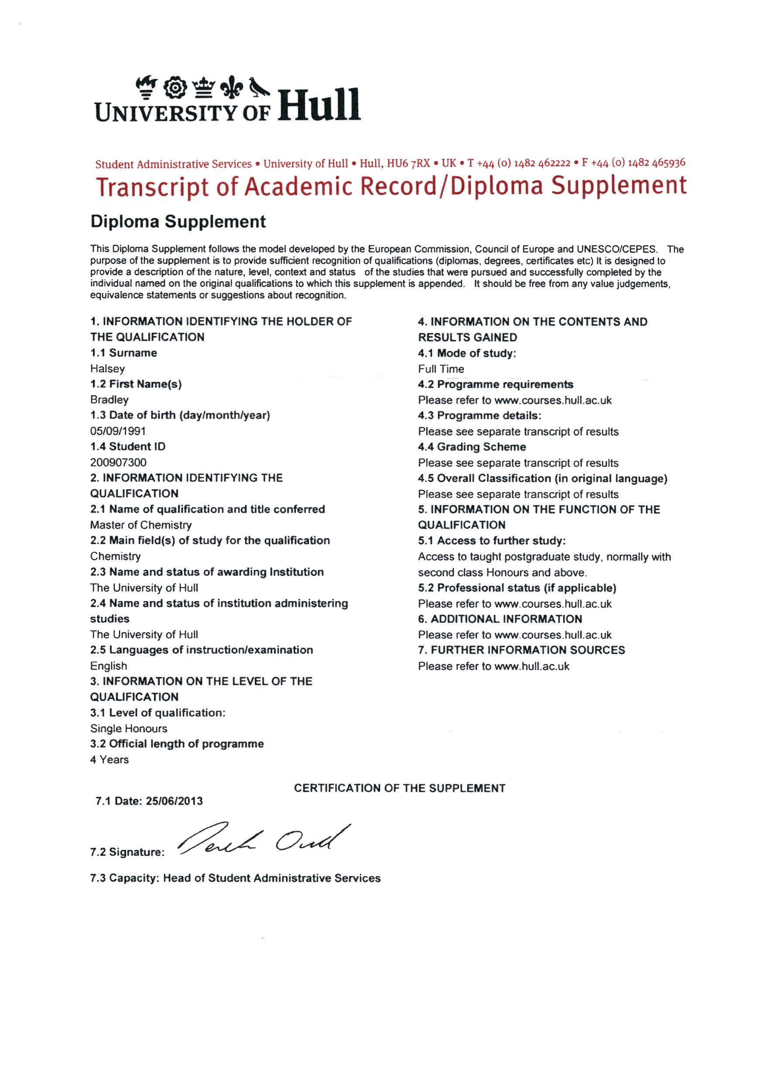

Slide 35
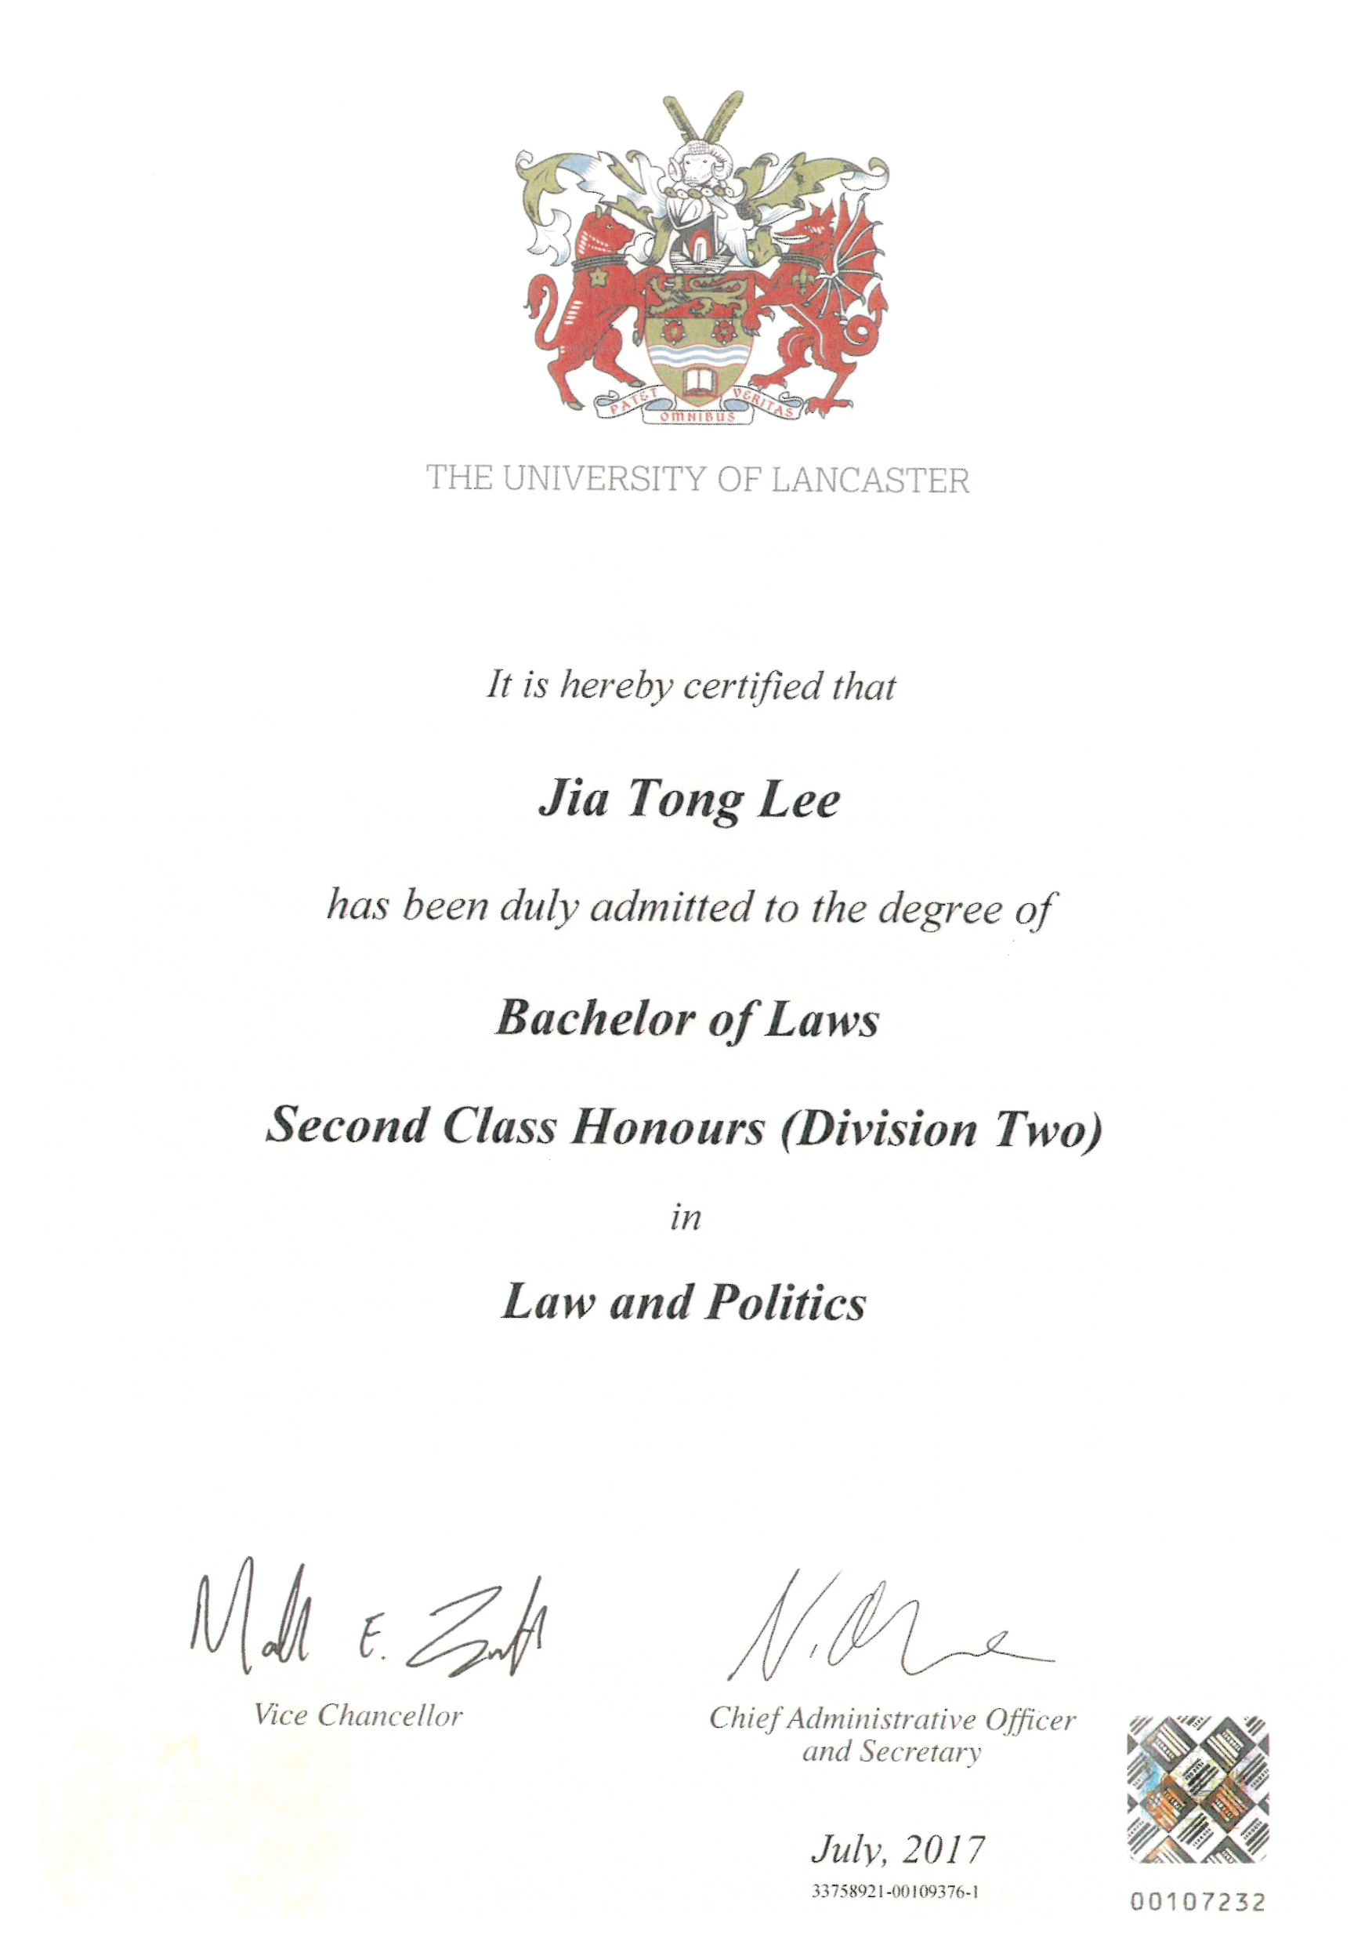
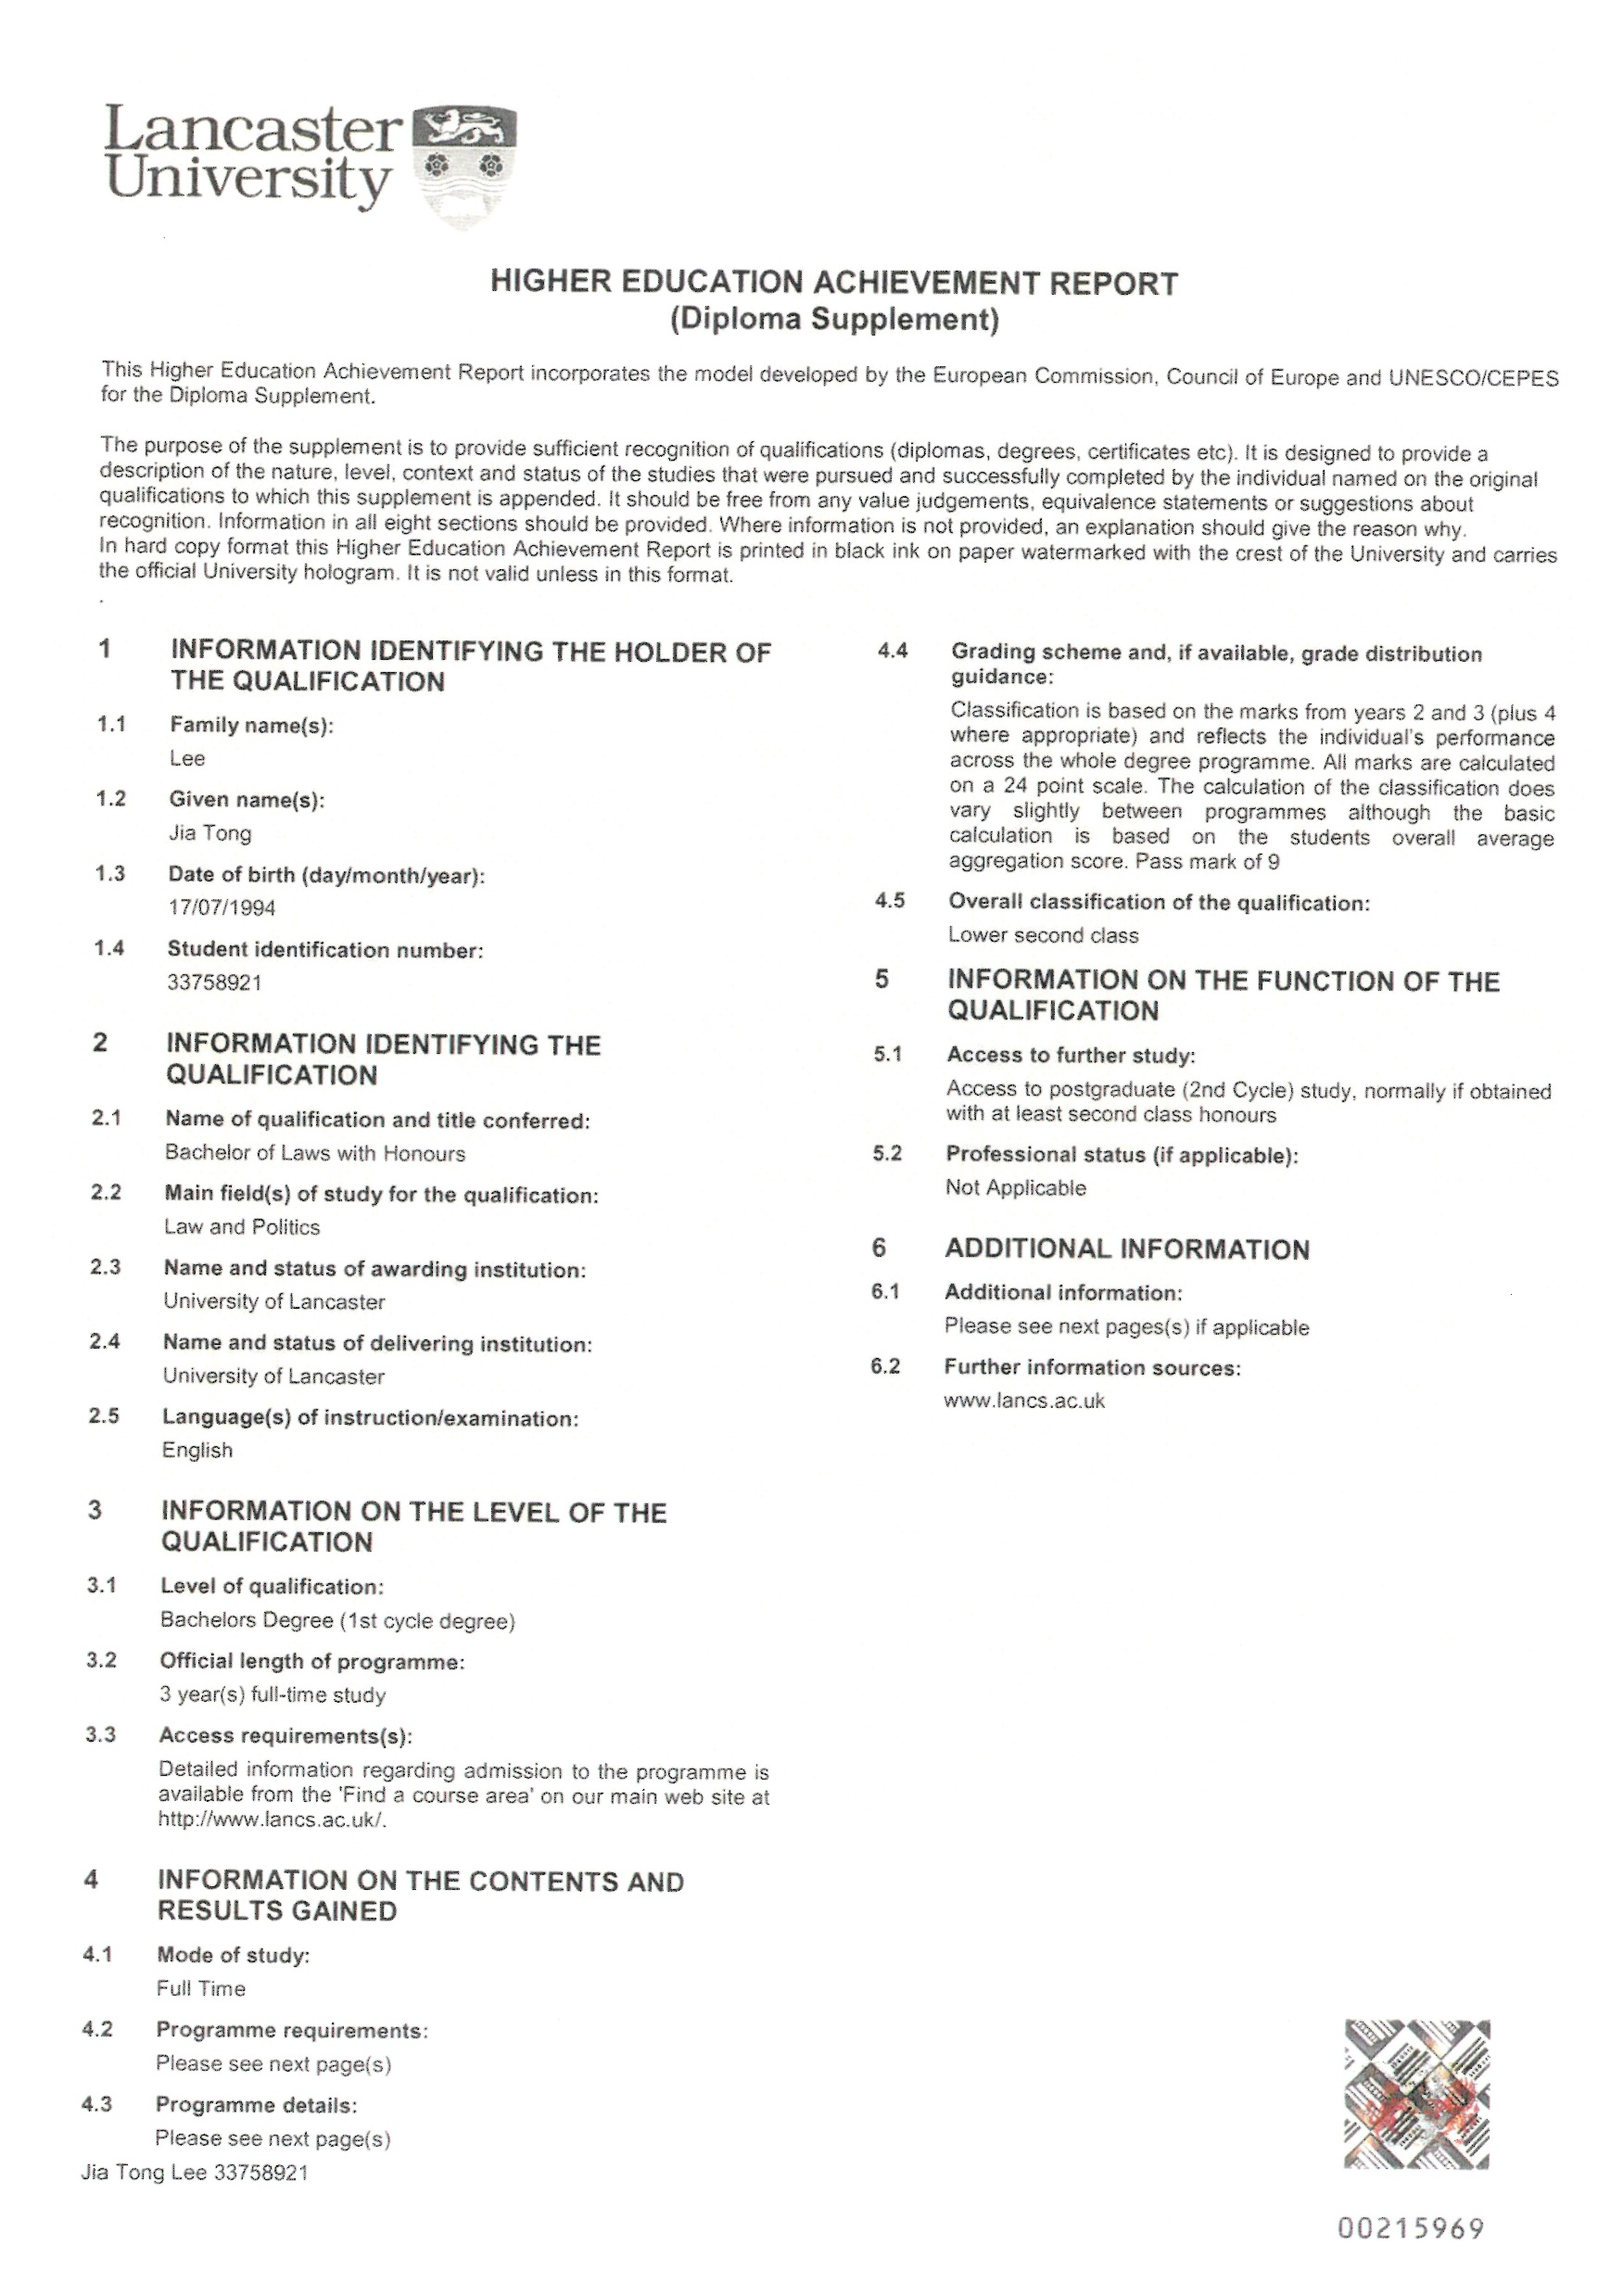

Slide 36
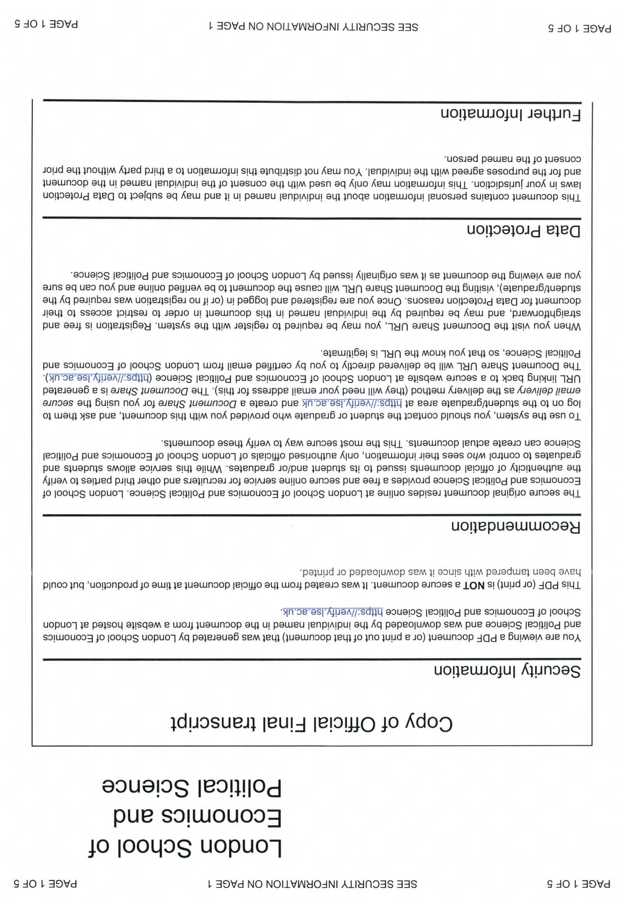

Slide 37
Higher education: non-degree
    Higher National Certificate/Certificate of Higher Education (NQF Level 4):
      1 year HO (first year Bachelor); often followed in parttime 2 years
      HNC more practical and applied than CertHE
      120 credits
      Entry requirements lower than for Bachelors: 1 A level + GCSEs or BTEC Level 3 (Extended) Diploma
    Higher National Diploma/ Diploma of HE (NQF Level 5):
      2 years HO (second year Bachelor);
      HND more practical and applied than DipHE
      240 credits
      Entry requirements: zie HNC.
      Advanced standing, pathway to second or third year Bachelor (top-up program).
      Exit award after first year: HNC/CertHE

Slide 38
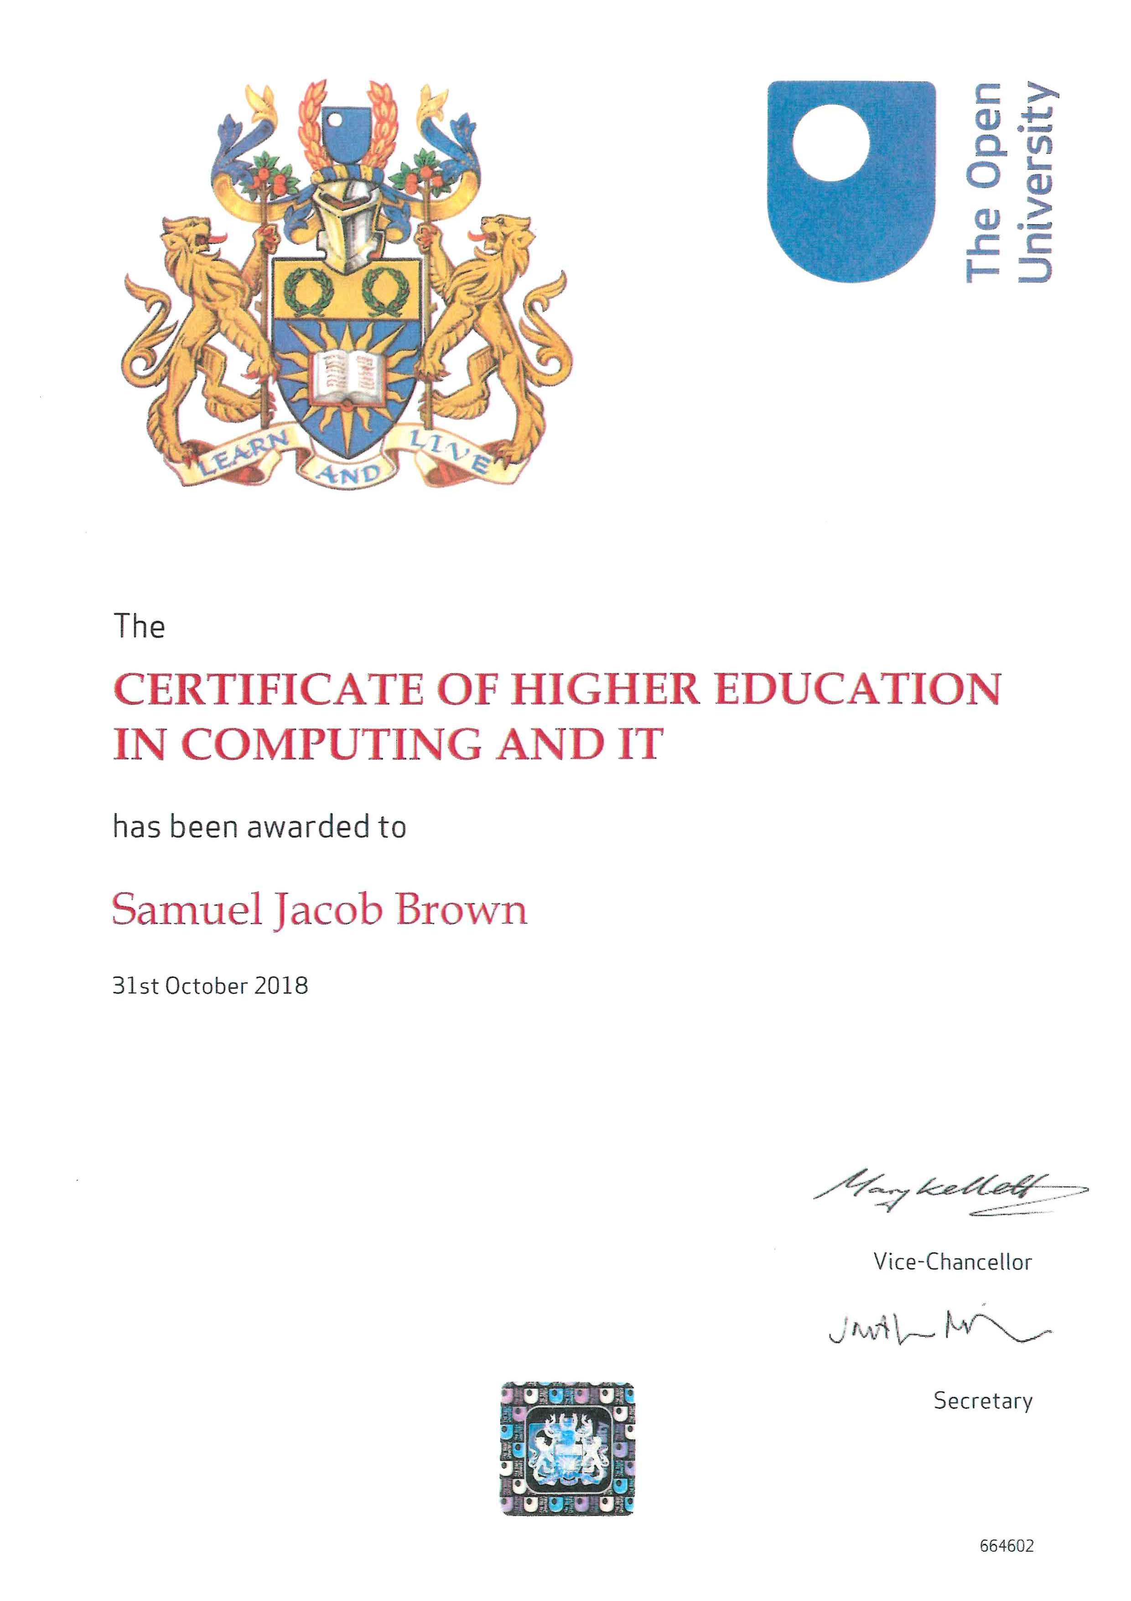
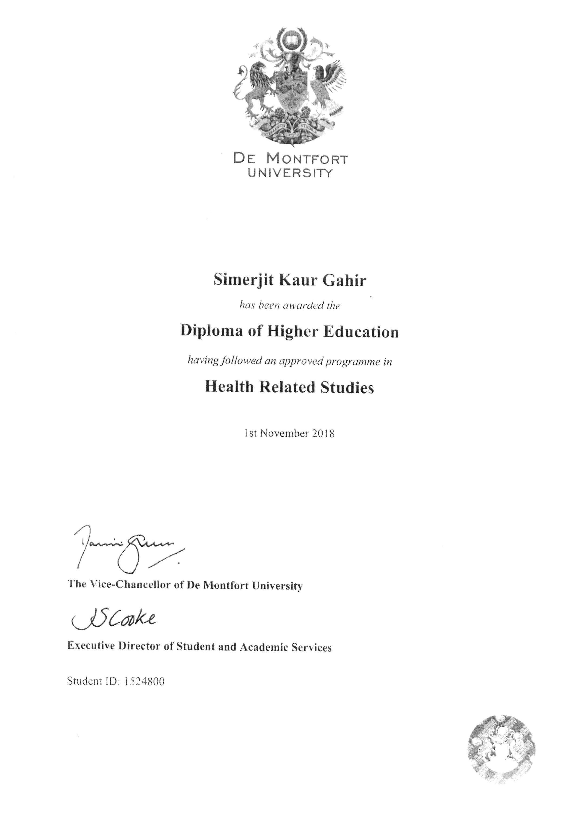

Slide 39
Ordinary vs Honours
(Please use the chat)
Question 1: how many credits are minimally required for an Ordinary Bachelor and how many for an Honours Bachelor?
Question 2: Can you continue your study into a master’s programme with both types of Bachelors?

Slide 40
Degree education: Bachelor (NQF Level 6)
  3 year Bachelors (Honours) of 360 CATS (= 180 ECTS) (NQF Level 6):
    Sometimes 4 year program including a sandwich year (placement/exchange)
    Ordinary Bachelors: between 300 and 359 CATS, no access to master’s and no Honours mentioned behind the degree.
    Exit awards per jaar: CertHE, DipHE, Ordinary Bachelor.

Slide 41
Degree education: Bachelor (NQF Level 6)
  3 year Bachelors (Honours) of 360 CATS (= 180 ECTS) (NQF Level 6):
    Classification honours: First class, Second class first division 2:1/Second class second division 2:2, Third class. (2:2 and Third class not always admitted to Master’s programmes).
    NB: compensated pass/condoned pass: have all credits been obtained?
    Module pass mark: 40%

Slide 42
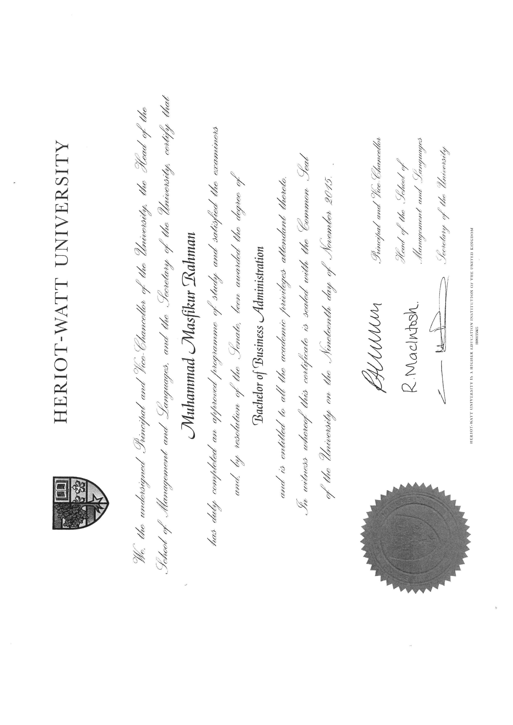

Slide 43
Condoned pass
To condone = odpustit, přehlížet
Student failed the subject, but does obtain the credits
Hons Bachelor: max. 20 credits p/yr condoned (1/6)
Obtained mark is mentioned with CP added
Master: 45%-49% marks, max. 30 credits condoned (1/6)
Notes:
https://my.cumbria.ac.uk/Student-Life/Your-Studies/FAQs/I-failed-a-module-but-it-has-been-condoned-What-does-this-mean/

Slide 44
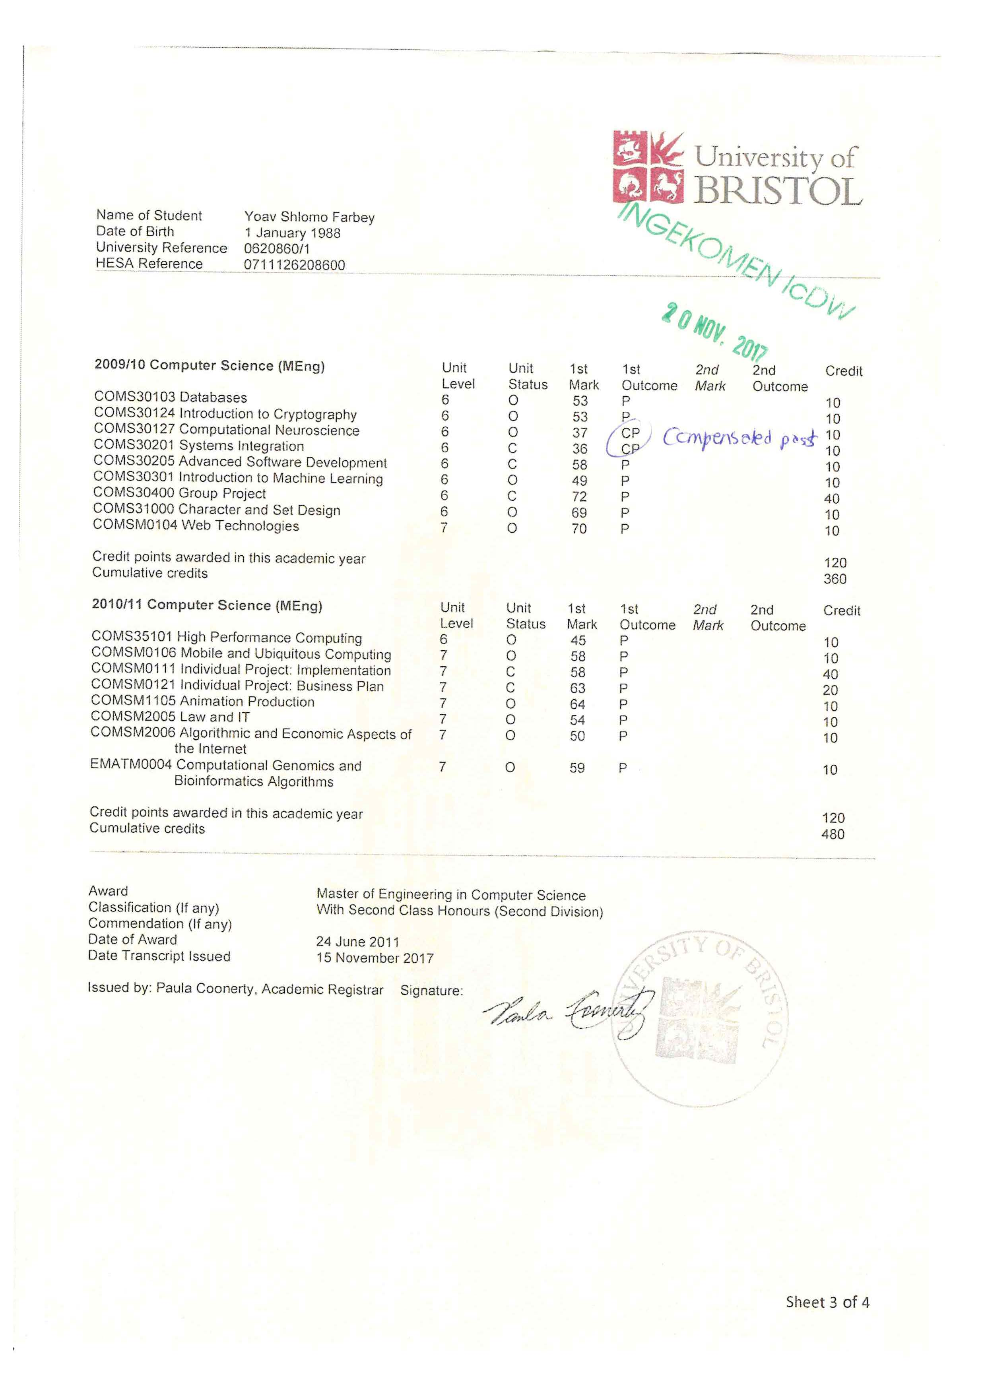

Slide 45
Degree education: Masters (NQF Level 7)
  Masters of 1 year (180 CATS) = 12 months of study; pass/merit; no Honours classification
  Integrated Masters of 4 years in technical fields. 480 CATS + Honours classification
  Module Pass mark Master: 50%
  Degree classification: Distinction (70%), Merit (60%), Pass (50%)
  Integrated Master: Honours classification.
Notes:
Aberdeen, Strathclyde, Glasgow, Edinburgh, Heriot-Watt, Dundee, Stirling, St Andrews, Robert Gordon.

Slide 46
Degree education: Master of Arts (!)
    Please note!
    Old Scottish universities issue for historical reasons for 4 year undergraduate programmes the MA (Hons) degree with classification; these are seen as equivalent to undergraduate Bachelors (NQF Level 6).
    Aberdeen, St Andrews, Edinburgh, Glasgow, Dundee and Heriot-Watt.
    So: Master with honours classification > 2 possibilities: Scottish ór integrated master
    2 year Master of Philosophy (MPhil): research master (NQF Level 7)
    PhD: 2 – 3 years, also professional doctorates (e.g. DBA) (NQF Level 8)
Notes:
Aberdeen, Strathclyde, Glasgow, Edinburgh, Heriot-Watt, Dundee, Stirling, St Andrews, Robert Gordon.

Slide 47
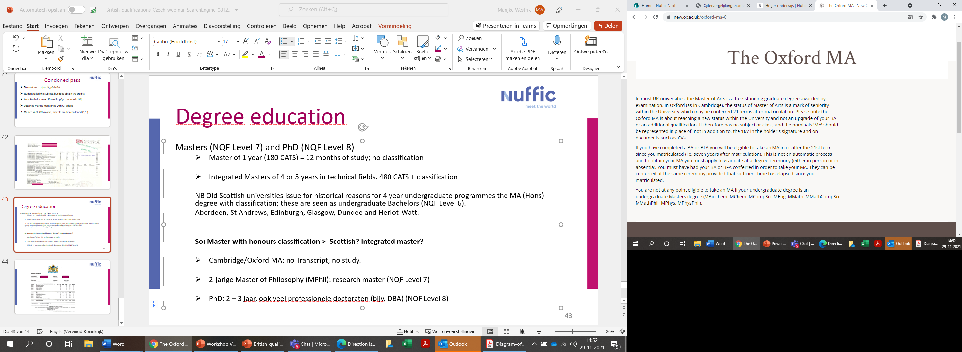
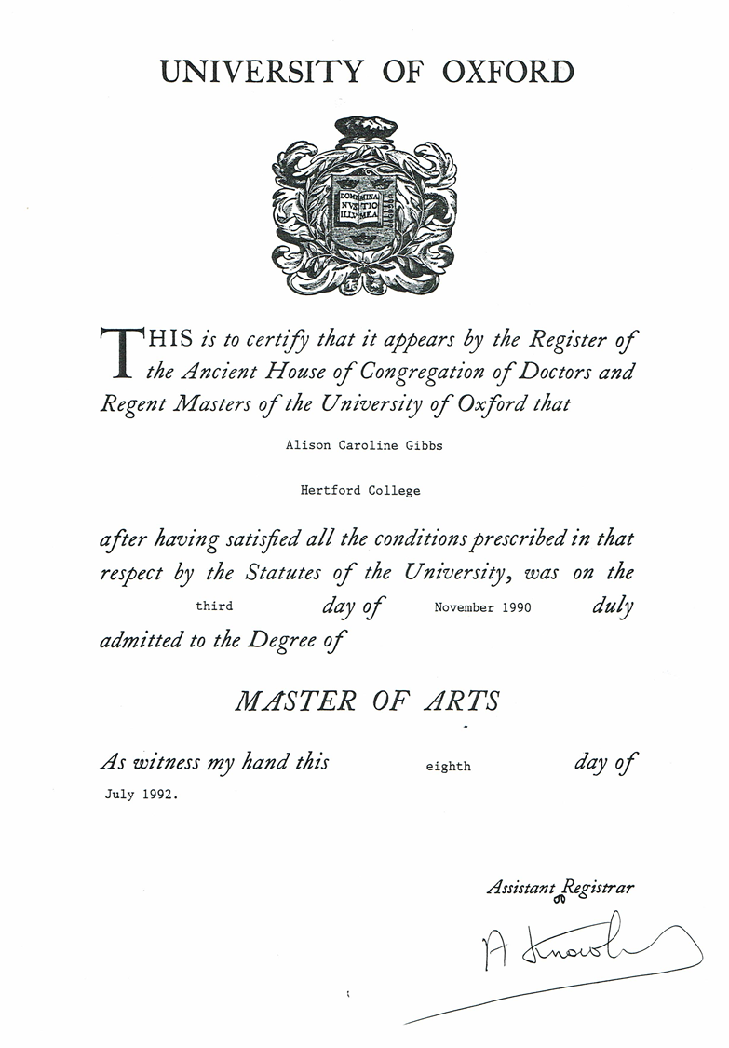
Cambridge/Oxford MA: no Transcript, no study. Issued 2 years after obtaining undergraduate degree.

Slide 48
4 year program
Master with classification Honours!
Integrated master

Slide 49
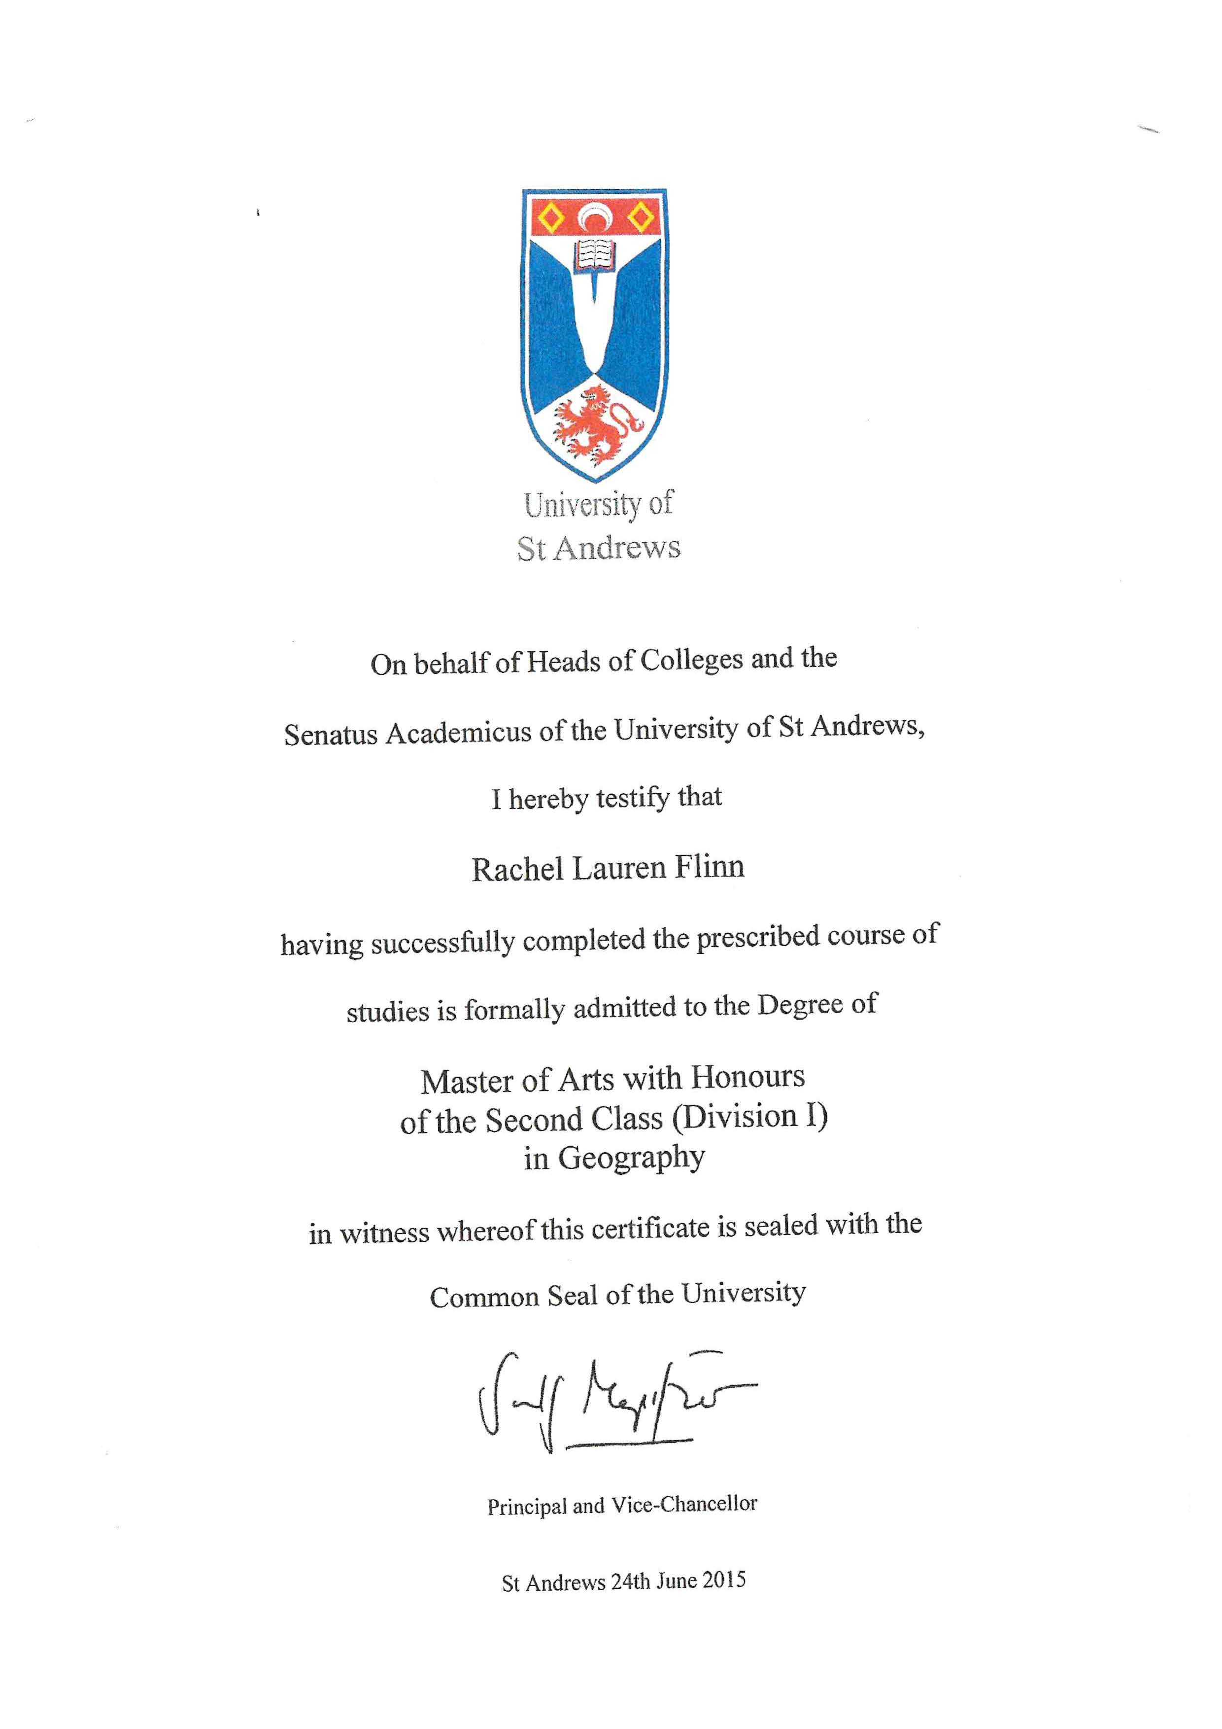
Scottish 4 year undergraduate MA
= bachelor equivalent
Only with MA, not MSc or other Master degrees
Notes:
4-jarige Schotse honours master MA > WB

Slide 50
Questions from participants
In the UK, the university may recognise the experience/professional practice and allow entry to the follow-up MSc. degree, whereby the graduate then has a diploma at a recognised school, various types of graduation (pass with merit, etc.).
Are there any changes to the recognition of education after the UK left the EU? Yes, professional recognition.
The issue of top-up programmes.
Can you please explain the level of the first level qualification of the Professional Diploma from the Open University? https://web.archive.org/web/20100124015806/http://www3.open.ac.uk/study/postgraduate/qualification/D64.htm 60 credit points, Postgraduate education. Part of MBA/MPA/MSc in HRM/MSc in Int Finance and Management. Not in Ofqual, OU internal qualification.
The Nuffic website contains descriptions of some countries' education systems. These descriptions used to include anonymised samples of certificates and diplomas or attachments to these documents. These models have been a valuable aid in the case of recognition of education from countries that are not entirely conventional. Unfortunately, the current version of the website no longer contains the models. Are these templates available elsewhere, or is Nuffic considering returning them?

